Slide 1
System Fusion by Yaesu A Comparison to D-Star
By John Bartos (AB3LZ)

Slide 2
History of Digital Modes in Land Mobile Radios
1980’s: first digital LMR radios appear, using GMSK (GFSK) technique (EDACS or TETRAPOL systems)
1989: APCO Project 25 established to develop standards for public safety digital radio communications.
1992: 4CFM is adopted as the P25 modulation standard and the first digital public safety radios hit the market.
2004: Icom’s D-STAR released; it also uses GMSK
2011: Motorola LMR’s Digital Mobile Radio (DMR) released, using C4FM; DMR-MARC demonstrated it for Amateur Radio at Dayton (MotoTurbo).
System Fusion openly documented in 2013 by Yaesu.

Slide 3
Quick Review of Digital Transmission Techniques
There are two major characteristics of digital radio communication
Modulation Techniques
Multiplexing Techniques
There are a number of different techniques and subcategories of techniques.
We will only review those used by System Fusion and D-Star.

Slide 4
Digital Modulation Review
Modulation Techniques
Modulation is the process of encoding information from a message source in a manner suitable for transmission.
The ultimate goal of a modulation technique is to transport the message signal through a radio channel with the best possible quality while occupying the least amount of radio spectrum.
Modulation may be done by varying the amplitude, phase, or frequency of a high frequency carrier in accordance with the amplitude of the message signal.

Slide 5
Digital Modulation Review

Slide 6
Digital Modulation Review
Minimum Shift Keying
It is a special type of continuous phase shift keying (CPFSK).
The name Minimum Shift Keying (MSK) implies the minimum frequency separation that allows orthogonal detection as two FSK signals VH(t) & VL(t).
MSK is a spectrally efficient modulation scheme and is particularly attractive for use in mobile communication systems because of its possesses properties such as :
● Constant envelope.
● Spectral efficiency.
● Good BER performance.
● Self-synchronizing capability
MSK uses changes in phase to represent 0's and 1's, but unlike most other keying, the pulse sent to represent a 0 or a 1, not only depends on what information is being sent, but what was previously sent.

Slide 7
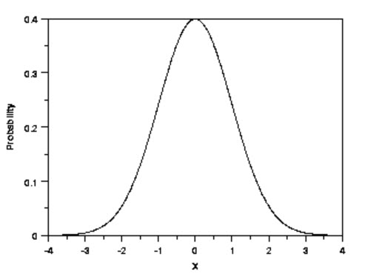
Digital Modulation Review
Gaussian Minimum Shift Keying (GMSK)
Even though MSK's power spectrum density falls quite fast, it does not fall fast enough so that interference between adjacent signals in the frequency band can be avoided. To take care of the problem, the original binary signal is passed through a Gaussian shaped filter before it is modulated with MSK.
The digital signal wave form is transformed into a Gaussian waveform.

Slide 8
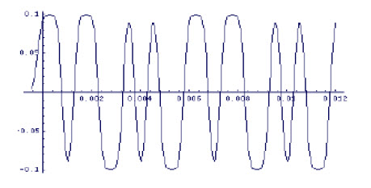
Digital Modulation Review The Effect of A Gaussian Filter

Slide 9
GMSK
Simple, used in earlier cell phone systems (GSM)
Performance exceeded by other systems
D-STAR uses GMSK

Slide 10
Digital Modulation Review

Slide 11
Digital Modulation Review
C4FM is a form of FSK using four frequencies.
Uses a deviation in frequency from a carrier frequency.
System P25 Specification
Dibit | Frequency Deviation
00 | +600 HZ
01 | +1800 HZ
10 | -600 HZ-
11 | -1800 HZ

Slide 12
C4FM Modulation
At same bandwidth, C4FM circuit can be simplified and the Bit Error Rate improved
Main modulation method in LMR these days (P25)
Yaesu is using this as the basis for System Fusion in the amateur market

Slide 13
Digital Modulation Review
C4FM is a form of FSK using four frequencies.
Uses a deviation in frequency from a carrier frequency.
System Fusion Specification
Dibit | Frequency Deviation
00 | +900 HZ
01 | +2700 HZ
10 | -900 HZ
11 | -2700 HZ

Slide 14
Multiplexing Modes
Two Modes Used:
Frequency Division Multiple Access (FDMA)
Time Division Multiple Access (TDMA)
FDMA
This mode divides the available frequency band into narrow bandwidth channels.
Compared to TDMA the circuitry is simple.
Used with P-25 Phase 1, GMSK and C4FM.
TDMA
Utilizes time slots so may signals can share same frequency.
Wider bandwith means shorter actual transmission time.
Battery life will be longer.
A two slot TDMA repeater will look like two separate repeaters.
Better voice quality.
Circuitry more complicated and expensive.
Used with P-25 Phase 2, Moto Turbo and is the European standard.

Slide 15
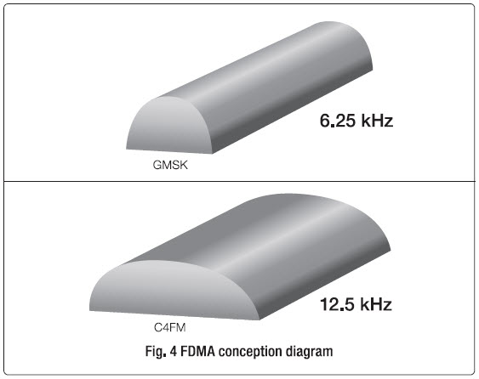
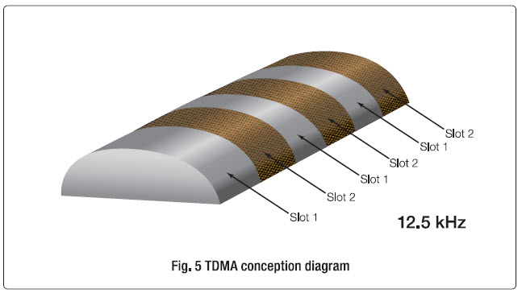
Multiplexing Modes

Slide 16
Is C4FM compatible with D-STAR?
No, it’s not; different modulation techniques (GMSK vs. C4FM)
Is this a problem in the amateur radio world?
Not really; an example of the experimentation that amateur radio is known for.
The fact that there is no vendor competition within a digital mode is perceived as a problem

Slide 17
Are Digital Modes Always the Superior Mode?
No, they are not; there will be instances when analog is superior.
We amateurs know that different modes have different advantages and that some are preferred in certain circumstances.
Digital and other modes are available to amateurs, increasing our capabilities; it’s more tools in our toolbox.

Slide 18
Comparison of Service Coverage and Reliability

Slide 19
Comparison of Bandwidth

Slide 20
Comparison of Communication Data Speeds

Slide 21
Yaesu’s C4FM Implementation: System Fusion
Three C4FM modes, using 12.5 kHz bandwidth:
V/D Mode – Voice/Data simultaneous communication, half for voice, half for data and error correction
Voice FR (full rate) Mode – all bandwidth used for voice, top audio quality
Data FR (full rate) Mode – all bandwidth used for data
Analog FM – 16 kHz; used when signals too weak for digital
Four modes fused into one system therefore the name: System Fusion

Slide 22
System Fusion Digital Modes
V/D Mode: Improved error correction codes provide fewer interruptions with higher voice quality.
Voice FR Mode: Highest quality voice for rag chews.
Data FR Mode: Transmits large quintiles of data at high speed like photo’s.
FM Mode: Still available for weak signal strength situations

Slide 23
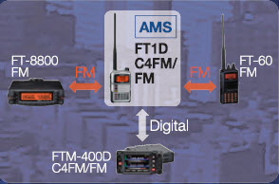
AMS (Automatic Mode Select)
Transceiver recognizes the incoming mode (C4FM digital or analog FM) and switches over to match that mode
No need to remember to manually switch the mode on the transceiver
Enables mixed-mode communication on compatible repeaters
If a System Fusion repeater is installed, you’re not locked out if you don’t have a System Fusion transceiver

Slide 24
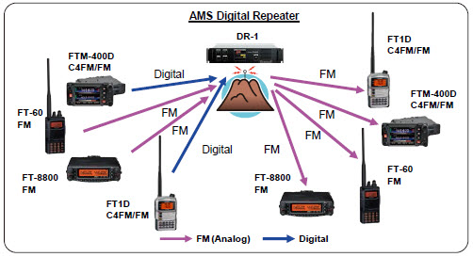
Repeater TX and RX Modes Can Be Independently Set
Repeater receive and transmit modes can be independently set to Auto or a specific mode.

Slide 25
New Functions Gained With System Fusion/C4FM
Digital GM (Group Monitor) Function – see where group members are located
Snapshot Function – transmit images taken with camera microphone
Smart Navigation Functions
Simultaneous Voice and Data transmissions allows APRS-type position data to be sent while transmitting
Backtrack navigation – allows one to return to a preset point (useful for hiking)

Slide 26
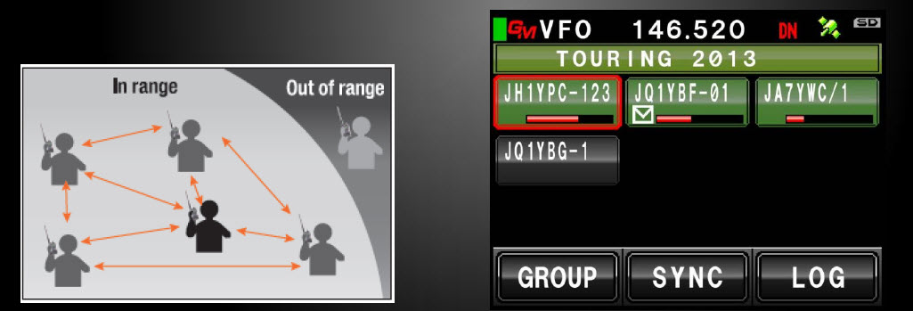
Digital Group Monitor Function
Automatically checks whether members registered to a group are within the communication range. Displays information such as the Distance and Orientation for each call sign on the screen.

Slide 27
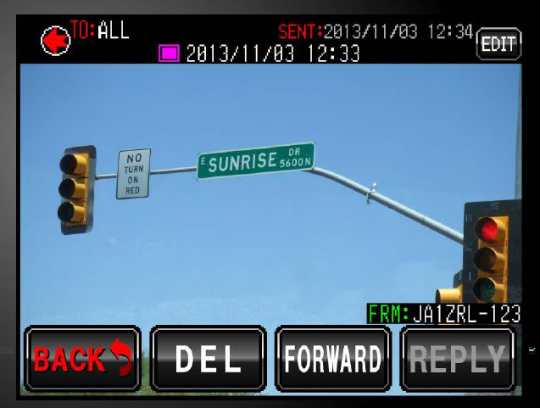
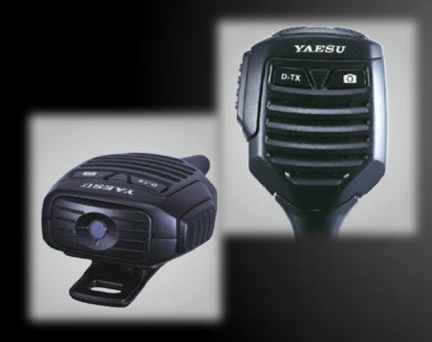
Snapshot Function

Slide 28
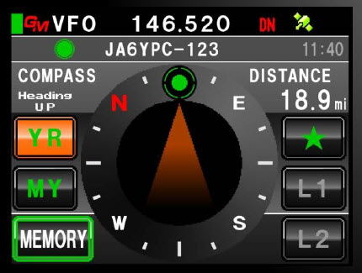
Smart Navigation Function
In digital V/D mode, information such as position data is transmitted together with voice signals so the distance and direction to the other stations can be displayed in real-time while communicating with them.

Slide 29
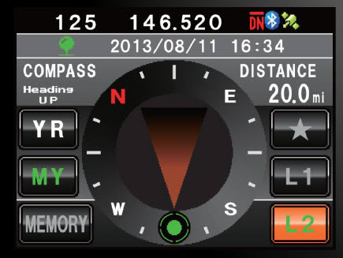
Backtrack Function
Enables navigation to a registered location at the touch of a button. When hiking or camping, simply register your starting point or campsite before departure. The distance and orientation from the current location is displayed on the screen.

Slide 30
Wires-X Internet Linking
WIRES-X was JUST released in the US so overall details and impressions are still too early
- HRO has 100+ on backorder as of 1/17/15
Fusion Internet Rooms are being established
“Rooms” are like IRLP Reflectors or Echolink Conferences
When in a room, you can download “news” which can be text files, audio, & pictures
Admins can individually “kick” or even “ban” call signs.

Slide 31
Equipment That Is System Fusion/C4FM Capable
Repeater DR-1X 144/430 dual band C4FM/FM repeater
HT FT1DR 144/430 dual band C4FM/FM 5W transceiver with GPS
Mobile FTM-400DR 144/430 dual band C4FM/FM with GPS and APRS 50W transceiver
HT FT2DR 144/430 dual band C4FM/FM 5W transceiver with GPS and APRS
HRI-200 WIRES-X internet linking kit

Slide 32
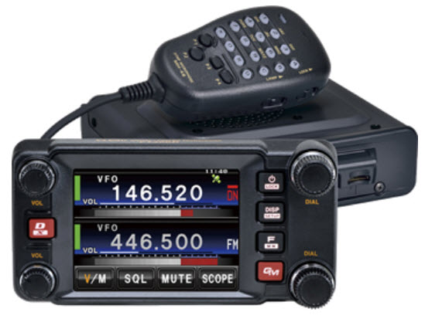
System Fusion Hardware
FTM-400DR
FT1DR

Slide 33
System Fusion Hardware
DR-1X
FT2DR

Slide 34
System Fusion Hardware
HRI-200

Slide 35
System Pro’s
D-Star
Large Established User Base
Extensive Internet Infrastructure
Time Tested (It Works)
Digital Advantages
System Fusion
Flexible Multiple Modes
Compatible With Old FM Gear
Superior Sound Quality
Greater Data Transfer Rates
Larger Data Bandwidths
Apparent Price Advantage (~$100)
Incorporate technology developed form P25 (i.e Error Correction)
Plug and Play
Digital Advantages

Slide 36
Challenges to Fusion’s Adoption
Like D-star, there is only one vendor supplying C4FM Fusion radios today – Yaesu.
Unless others start making compatible and competitive radios, the technology can only go so far.
Unclear if a similar D-Star homebrew community will happen like GSMK boards, Dongles, DVAPs, etc.
Wires-X modules are registered by serial number so this might hinder the home brew community.

Slide 37
Some Published First Impressions Of C4FM Audio
Seems to have a quality edge over D-star.
Said to be about the same audio quality as DMR (MotoTurbo).
Degrades better than D-star on fringe coverage.
Still doesn't have the fidelity of a full quieting FM analog signal.

Slide 38
System Fusion Market Potential
There are approximately 7000 FM VHF/UHF repeaters in North America.
There are 728 FM VHF/UHF repeaters in PA.
There are approximately 700 D-Star repeaters in North America.
There are 18 D-Star repeater in PA.
Yaesu views all 7000 existing FM repeaters as a potential market opportunity.
The DR-1X repeater replacement offer ($500) is one facet of their marketing plan to tap into this market.

Slide 39
System Fusion Repeater Status
318 System Fusion Repeater World Wide.
240 System Fusion Repeaters In the USA.
143 – 2 Meter Repeaters
97 – 70 CM Repeaters
17 System Fusion Repeaters in PA
8 -2 Meter Repeaters
9 – 70 CM Repeaters
11 System Fusion Repeaters in NJ
5 – 2 Meter Repeaters
6 – 70 CM Repeaters

Slide 40
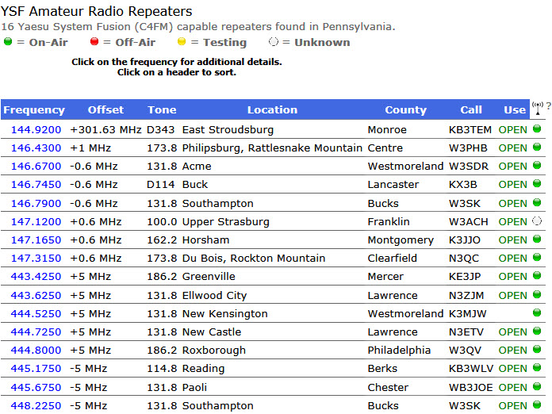
PA System Fusion Repeaters

Slide 41
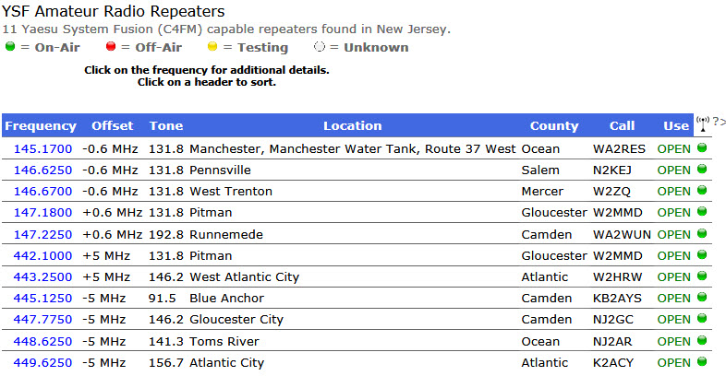
NJ System Fusion Repeaters

Slide 42
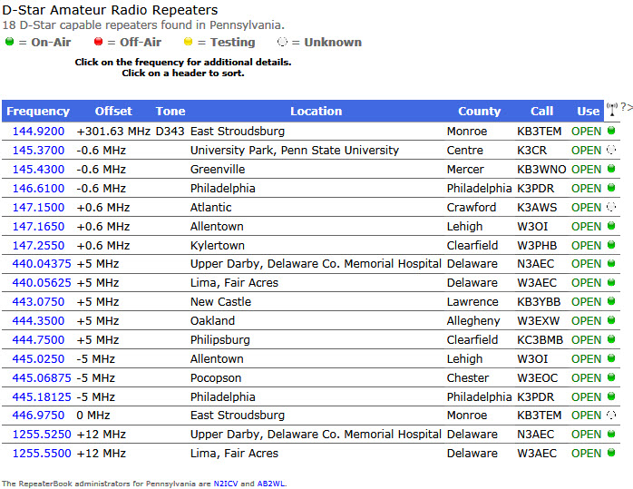
PA D-Star Repeaters

Slide 43
Final Thoughts
System Fusion evolutionary not revolutionary.
Armature radio version of P25 (phase 1).
Wider bandwidth than D-Star means better audio, faster data transfer rates and better error correction.
Nice digital bridge to older analog FM gear.
System Fusion is plug and play.
Targets a larger potential market than D-Star.
System Fusion is late to the game but maybe not out of the game.

Slide 44
Final Thoughts
A truly revolutionary land mobile radio system:
Software defined radio.
Non proprietary completely open hardware and software (voice codex).
Hardware vendors are not mode developers.
Radio specifications are completely open to application developers.
Third party vendors would develop modes as Apps.
Modes would be downloadable Apps.
P25, D-Star, Moto Turbo, Fusion, etc. would all be downloadable Apps.
Similar to cell phone/tablet market.
Open to experimentation and development in the true armature radio spirit.

Slide 45
Questions

