Slide 1

QRP
Low Power Ham Radio
Less than 5 watts
By John Bartos (AB3LZ)

Slide 2
QRP In General
What is QRP and Why Use It?
Overview of QRP Kits
  Small Projects
  Intermediate Kits
  Advanced Kits
Using Commercial Amateur Radios for QRP
Clubs, Web Sites & References
Questions

Slide 3
What is QRP
A telegraphy Q-signal
  “QRP” = To lower ones power.
  “QRP?” = Can you lower your power?
Five watts RF output power (or less)
  Use a “QRP rig or
  Turn down your present radio

Slide 4
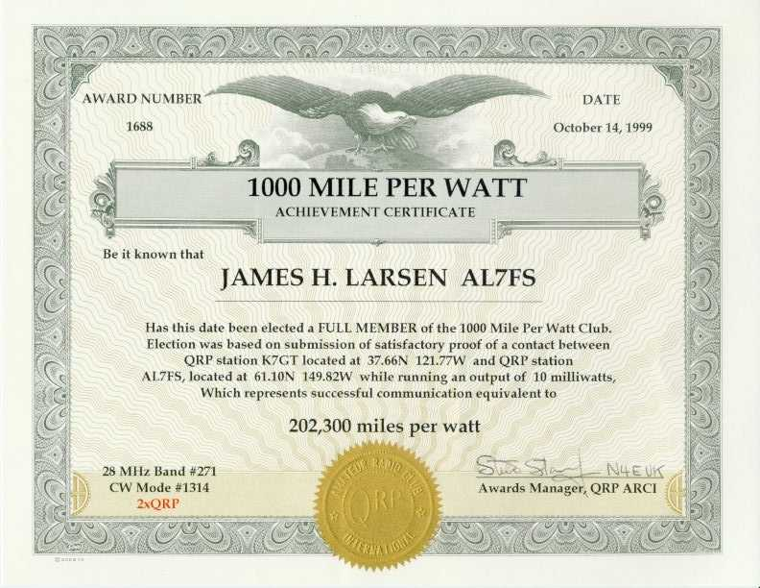
Pretty Amazing Stuff

Slide 5
Why QRP?
Many Reasons but let’s focus on:
Quality and simplicity of equipment
Joys of home brewing & kit-building
Portable Operations
Natural compatibility for CW and digital operating modes.
These are the essence of QRP.

Slide 6
QRP Optimization
1) Reduce size & weight by decreasing output power
2) Minimize current draw
  No lamps (except LEDs)
  No digital display unless LCD
  Maximize TX efficiency Class E
3) Use few components & pack the board tightly
4) Use ICs and SMDs if possible
5) Sensitive RX - If you can’t hear ‘em, you can’t work
em

Slide 7
Size and Weight vs. Max. Power
Conventional Icom 7200, etc. 12.1 lbs.
100w Tuner 6 lbs.
setup Astron RS-20A 18 lbs.
TOTAL 36.1 lbs.
TRANSPORT Trunk of Car
QRP setup ATS3 QRP rig 2.3 oz
Tuner 8.7 oz
Power supply (small battery) 18.2oz
TOTAL 29.2 oz /1.8 lb.
TRANSPORT Small Bag
and can operate all weekend without recharging battery

Slide 8
Power Requirements for a Day
To run for 18 hours - 50% xmit, 50% receive *
Conventional, compact HF rig (IC-706, Yaesu FT-890)
Receive - 2 amps…Xmit - 4 to 20 amps (avg. 10 amps)
TOTAL CONSUMPTION - 68 AH (a car battery)
ATS3 QRP- optimized rig
Receive - 25 milliamps…Xmit - 500 milliamps
TOTAL CONSUMPTION - 2.16 AH (a 7 oz LiPO)
*Using battery capacity calculator at www.wa0itp.com

Slide 9
Kitbuilding & Homebrewing
QRPers are natural builders and experimenters
Thousands of schematics are available
Many, many kits and projects are
available today
www.4sqrp.com
www.fix.net (Wilderness Radio)
many commercial suppliers

Slide 10
QRP In General
What is QRP and Why Use it?
Overview of QRP Kits
  Small projects
  Intermediate kits
  Advanced kits
Using Commercial Amateur Radios for QRP
Clubs & Web Sites
Questions?

Slide 11
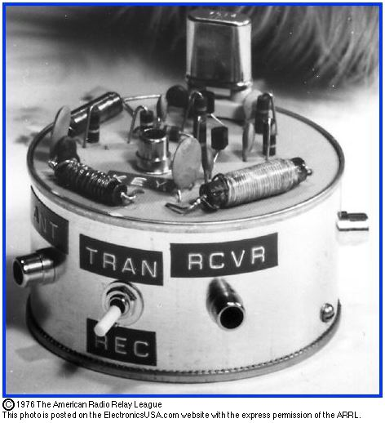
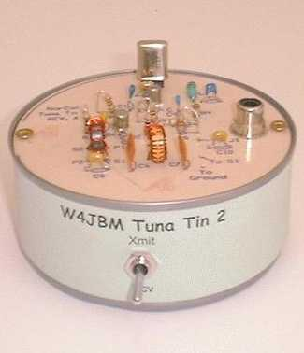
The “Tuna Tin 2”
Simple Transmitter, less than 1W
W1FB original design

Slide 12
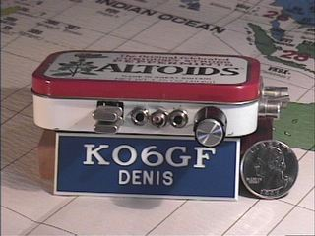
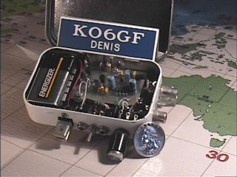
The “Pixie”
Simple 250mW transceiver kit from HSC Electronics

Slide 13
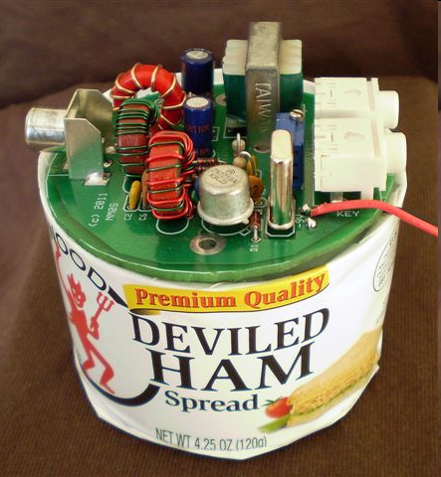
NMØS Ham Can Minimalist Xcvr
Crystal controlled, regen recvr, capable
only 2 transistors

Slide 14
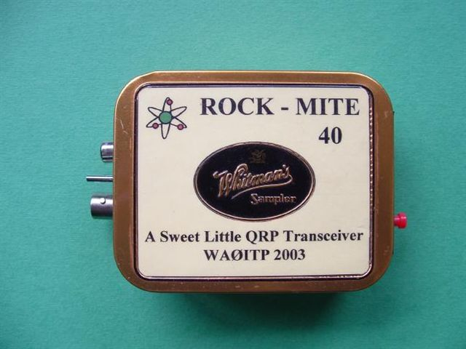
Rock Mite
DC XCVR CW kit from SWL
.5W output, XTAL controlled
Wildly popular, cult following
Rock-Mite/Small Wonders currently out of business
Kits available on Ebay

Slide 15
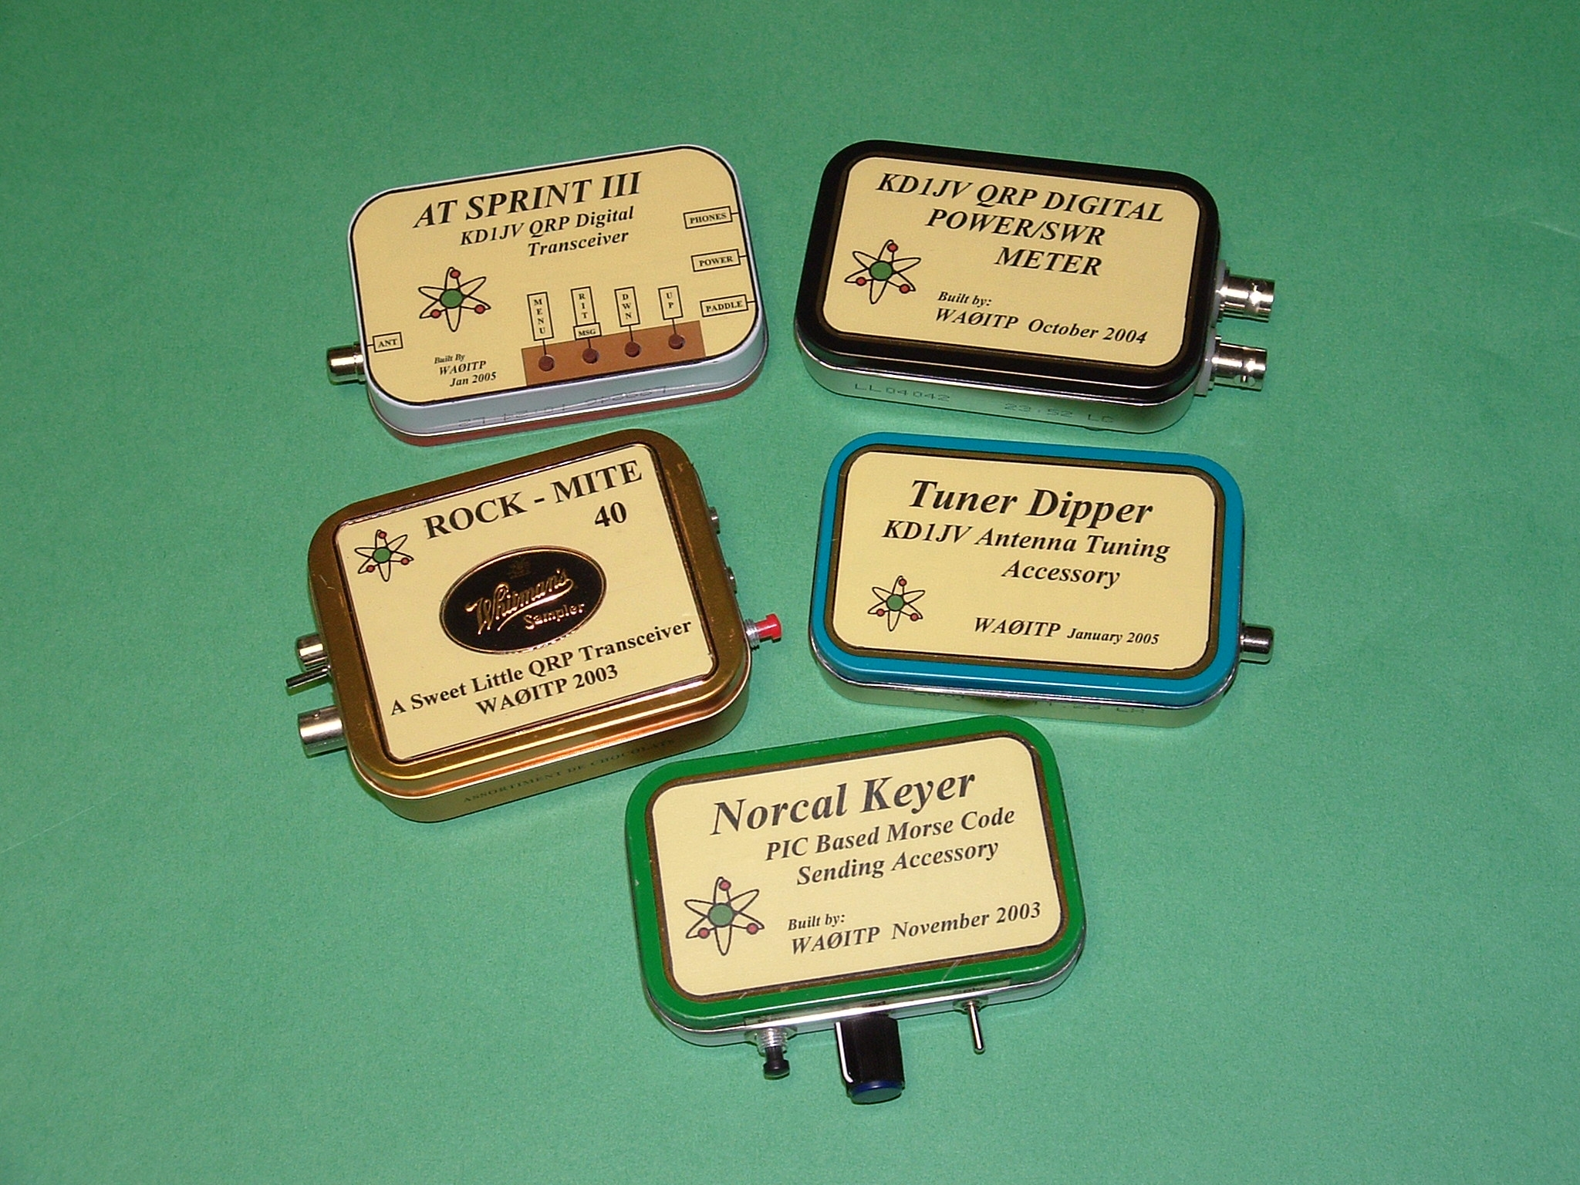
Nifty Projects in Altoids

Slide 16
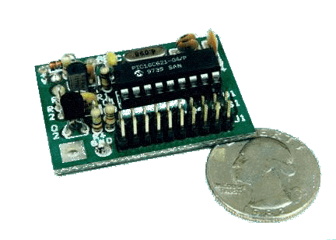
A Simple and Inexpensive Morse Frequency Display
Small Wonder Labs’ “Freq Mite”
PIC microcontroller as digital frequency meter

Slide 17
QRP In General
What is QRP and Why Use it?
Overview of QRP Kits
  Small projects
  Intermediate kits
  Advanced kits
Using Commercial Amateur Radios for QRP
Clubs, Web Sites & References
Questions?

Slide 18
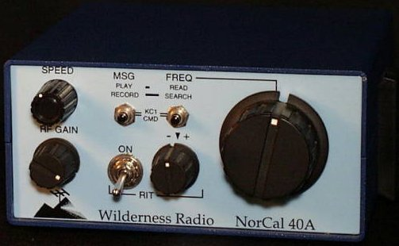
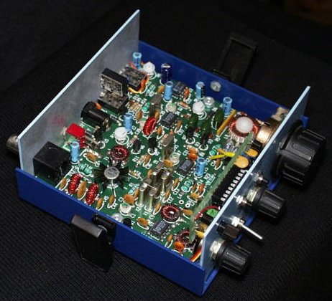
The NorCal 40A
Wilderness Radio (~$150)

Slide 19
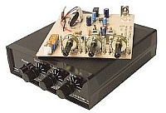
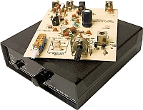
HSC 40 Meter Reciever & Transmitter
HSC Electronics – 50$ per Unit

Slide 20
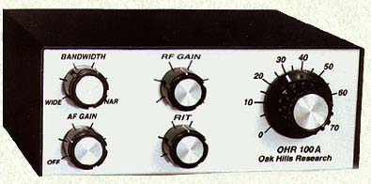
OHR – Oak Hills Research
The OHR 100A Single Band 5W CW Transceiver Kit $179.95
Options:
Electronic Keyer: $29.95-$39.95
Ten Turn VFO Pot: $17.95
Power LED: $9.95

Slide 21
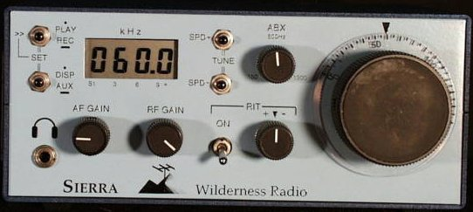
The “Sierra” by Wilderness Radio
The basic Sierra kit is $215, plus shipping ($9 U.S., $14 Canada/Mexico, $25 DX).

Slide 22
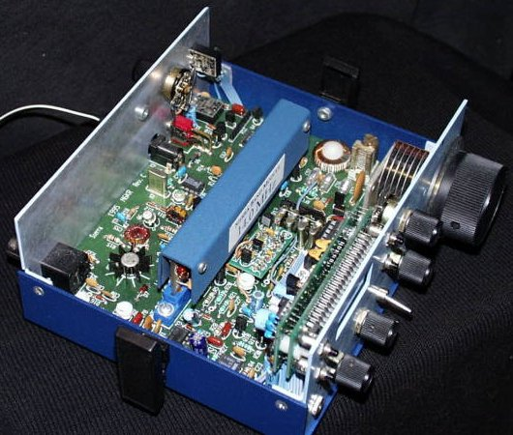
The “Sierra” by Wilderness Radio
The Sierra uses plug-in band modules for 80, 40, 30, 20, 17 and 15 meters. (You can build modules for the other bands by purchasing additional band module PC boards.) Since there is no band switch, and because all controls and connectors are mounted on the main board, there's virtually no chassis wiring.

Slide 23
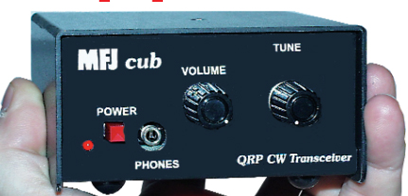
MFJ QRP CUB TRANSCEIVER KIT
Available in 15, 17, 20, 30, & 40 Meters
Kit - $99.95/Assembled $149.95
1

Slide 24
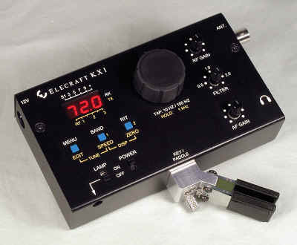
Elecraft KX1 CW Kit
Elecraft KX1 CW Transceiver Kit
4 Bands – 80, 40, 30, & 20 Meters
$299.95

Slide 25
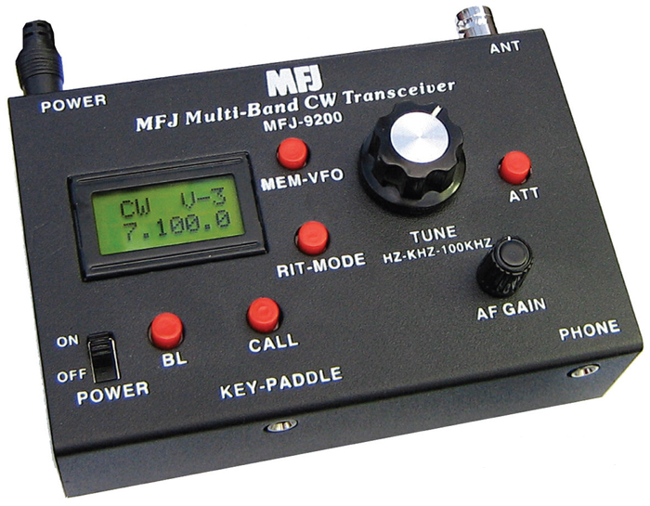
Non-Kit QRP Radios
MJF-9200 QRP CW XCVR W/Module, 5W - $199.95
15, 17, 20, 30, 40, 80 Meter Modules Available - $29.95

Slide 26
Non-Kit QRP Radios
MFJ-9296
QRP TRAVEL CW RADIO, 6-BAND, 80/40/30/20/17/15
$229.95

Slide 27
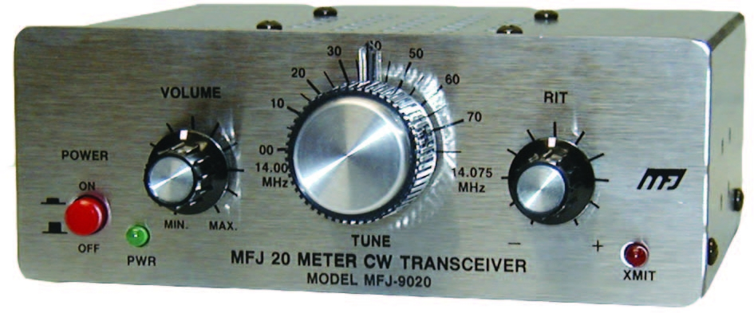
Non-Kit QRP Radios
MFJ-9000 Series CW Transceiver (5 W)
Available in 15, 17, 20, 30 & 40 Meters
$209.95
1

Slide 28
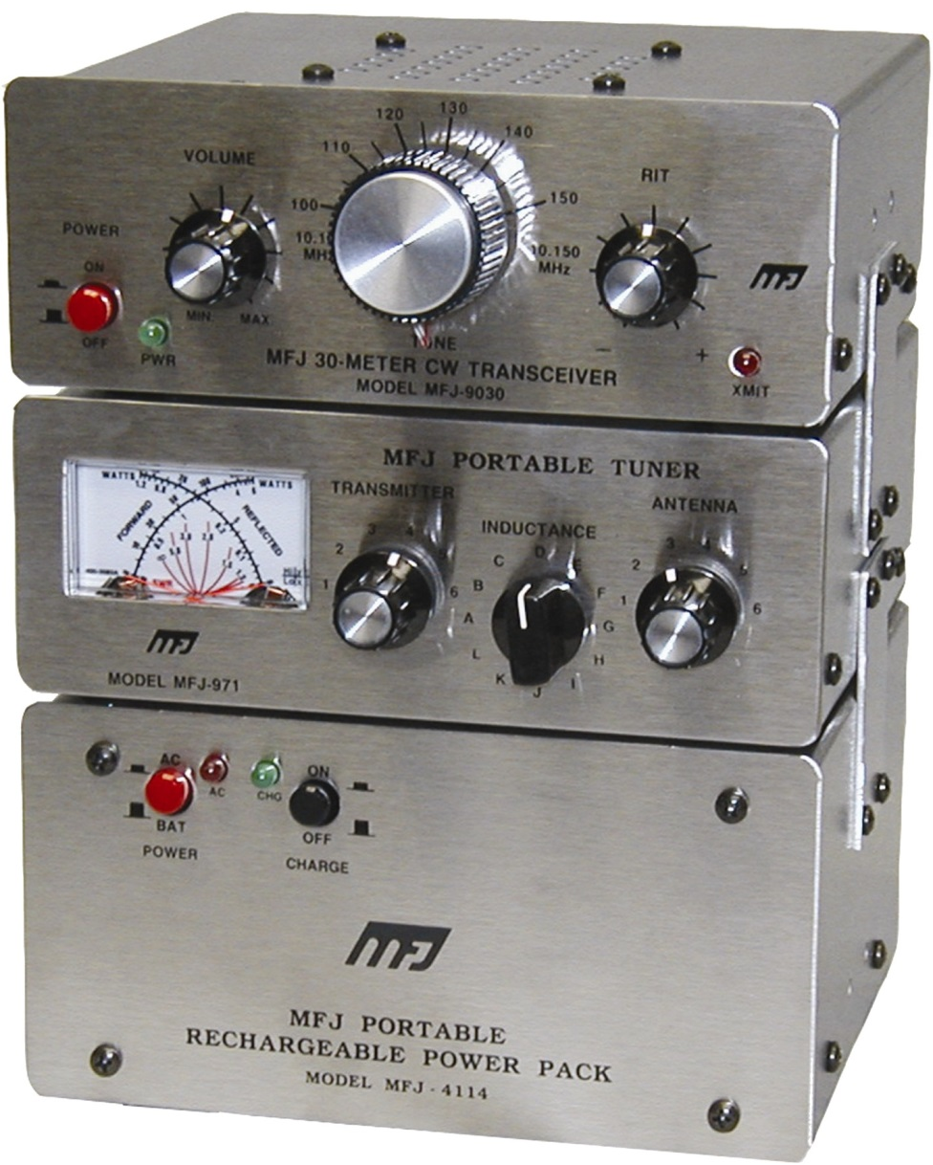
Non-Kit QRP Radios
MFJ-9100 Series
Deluxe CW Transceiver Station
Available in 15, 17, 20, 30 & 40 Meters
5 Watts
$348.80
1

Slide 29
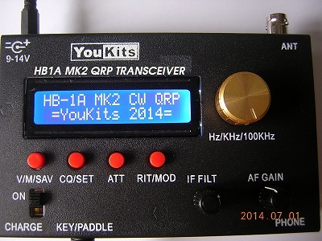
Non-Kit QRP Radios
YouKits HB-1A (2 Band) & HB-1B (4 band) QRP CW Transceivers
HB-1A - $239 & HB-2A - $299

Slide 30
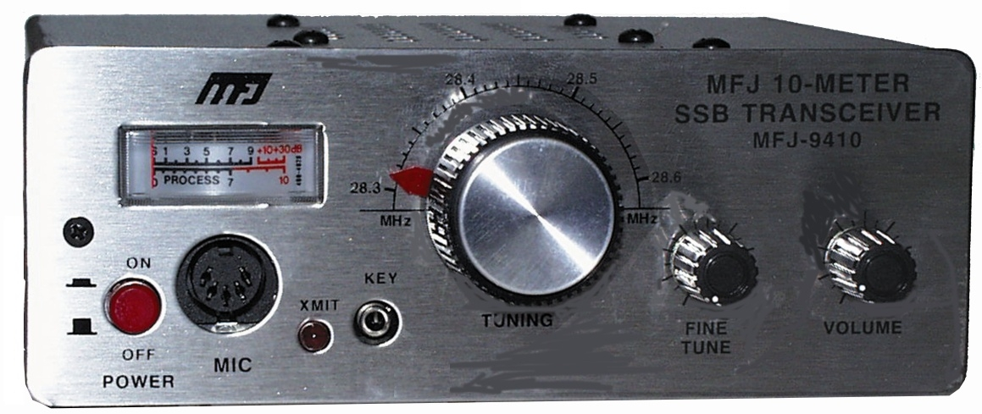
Non-Kit QRP Radios
MFJ- 9400 Series SSB QRP Radio (7 W Max)
Available in 2, 6, 10, 12, 15, 17, 20, 40 & 75 Meters - $259.95
1

Slide 31
QRP In General
What is QRP and Why Use it?
Overview of QRP Kits
  Small projects
  Intermediate kits
  Advanced kits
Using Commercial Amateur Radios for QRP
Clubs, Web Sites & References
Questions?

Slide 32
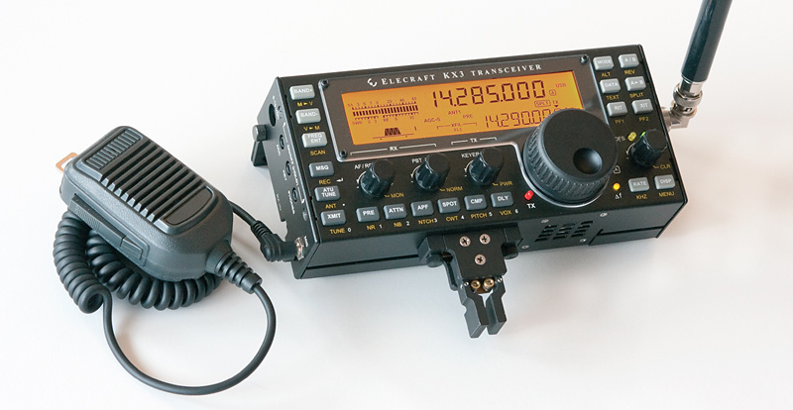
Advanced QRP Kits
Elecraft KX3 (10 W PEP) – SSB/CW/Data/AM/FM
160 to 6 Meters
1.5 Pounds
$899.95

Slide 33
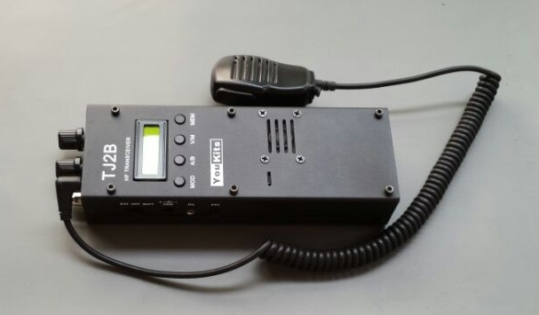
Advanced QRP Non-Kit
YouKits TJ2B – 3 Band Handheld HF SSB/CW Transceiver
40, 30 & 17 Meter Bands (3 to 5 Watts)
$329

Slide 34
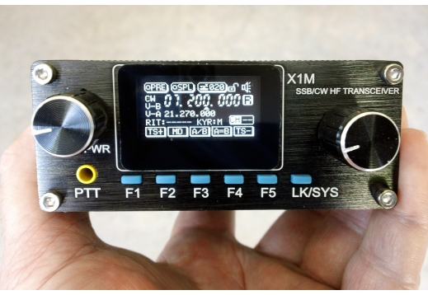
Advanced QRP Non-Kit
Xiegu X1M Pro QRP Transceiver (4.5 Watt)
SSB & CW
5 Band (80, 40, 20, 15 & 10 Meters)
$359.95

Slide 35
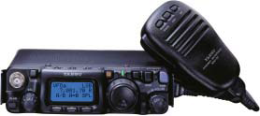
Advanced QRP Non-Kit
Yaesu FT=817ND
5 Watt all band all mode
All Bands 1.8 - 470MHz
Very Popular as a Portable Rig
Very Small

Slide 36
QRP In General
What is QRP and Why Use it?
Overview of QRP Kits
  Small projects
  Intermediate kits
  Advanced kits
Using Commercial Amateur Radios for QRP
Clubs, Web Sites & References
Questions?

Slide 37
Use Your 100 Watt Big Rig As A QRP Rig
Turn down the power while in QSO, you will be amazed at how low you can go and still maintain contact.
FCC Part 97.313(a) An amateur station must use the minimum transmitter power necessary to carry out the desired communications.

Slide 38
Commercial Amateur Radios
Easy way to try QRP - Turn down the power on your big rig
Here’s some power math
  dB = 10*log(pwr out/pwr in)
  5W is 13dB less than 100W
That’s only about 2 S units.
Take the challenge on your big rig, see how low you can go.

Slide 39
Commercial Amateur Radios
Kenwood
Icom
Yaesu
Elecraft
Ten-Tec
Alinco
Reduce power:
  Turn power down.
  Use attenuators if necessary
  Check with external watt meters.

Slide 40
QRP In General
What is QRP and Why Use it?
Overview of QRP Kits
  Small projects
  Intermediate kits
  Advanced kits
Using Commercial Amateur Radios for QRP
Clubs , Web Sites & References
Questions?

Slide 41

QRP Amateur Radio Club International
http://www.qrparci.org
QRP Quarterly (Official Publication)
1000 Miles per Watt Award
QRP DX Award (100 Countries)

Slide 42
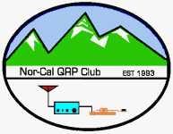
NorCal (Northern Califorina QRP Club)
Northern California QRP Club
http://www.norcalqrp.org

Slide 43

G-QRP Club – Great Britain
http://www.gqrp.com/

Slide 44


4 State QRP Group (4SQRP)
http://www.4sqrp.com

Slide 45

New England QRP Club
http://newenglandqrp.org/

Slide 46

The North Georgia QRP Club
http://www.nogaqrp.org/

Slide 47


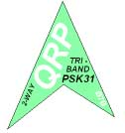
PODXS 070 Club
QRP is a natural fit for the sensitive Digital modes
  PSK31, JT65 & JT9
PODXS offers two awards for QRP operation on PSK31
- Bumper sized sticker for submitting a Brag file with your QRP setup.
- QRP Tri Band – Work three different stations on any three HF bands of your choice.
www.podxs070.com

Slide 48
QRP Equipment Vendors
Elecraft
MFJ
Pacific antenna
Yaseu
Youkits
Ramsey Electronics
Wilderness Radio/NorCal
Oak Hill Research
HSC Electronics
Rockmite/ Small Wonders (Ebay)

Slide 49
QRP References: Literature
QRP Power, published by the ARRL
QRP Classics, published by the ARRL
W1FB’s QRP Notebook, published by the ARRL
The History of QRP, by Adrian Weiss, W0RSP, ISBN 0-9614139-1-3
The Joy of QRP, by Adrian Weiss, W0RSP, ISBN 0-9614139-0-5
EMRFD Hayward, Campbell, Larkin by ARRL
Solid State QRP Projects, MFJ-3502

Slide 50
QRP is a growing and dynamic subculture within the Amateur Radio Hobby.
WHY?
Because it’s About Ham Radio FUN

Slide 51
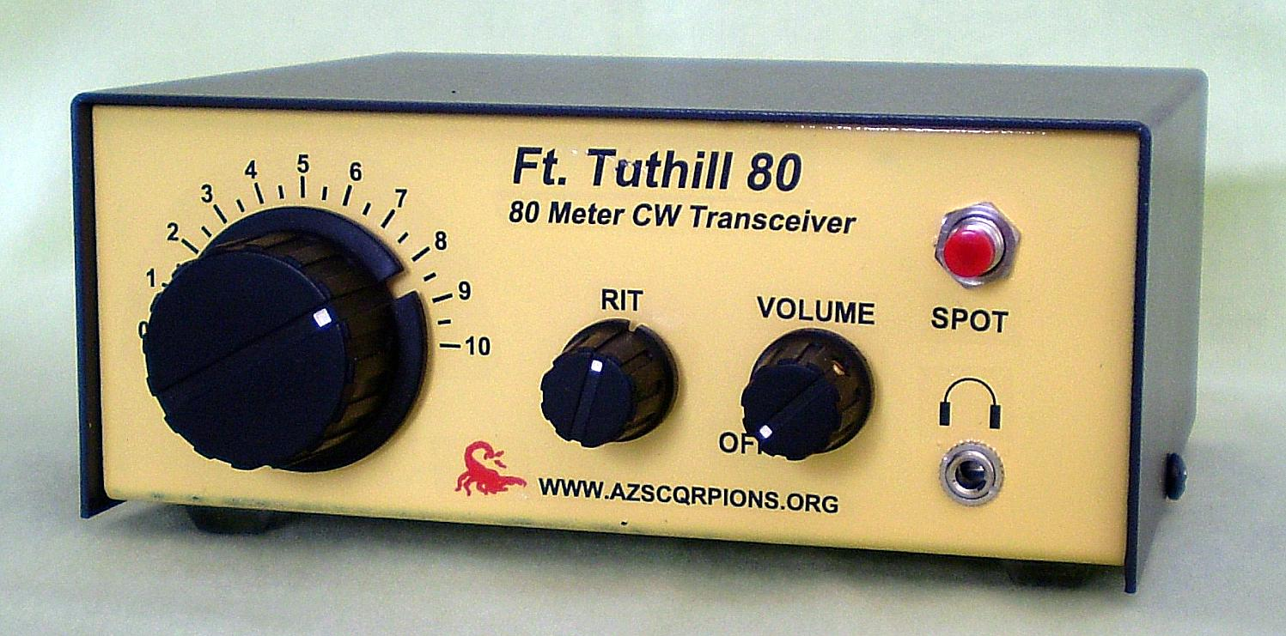
Thank You!
Questions?

