Slide 1
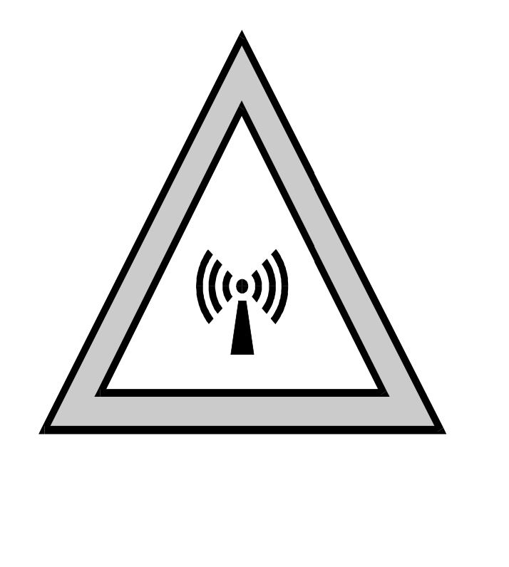
Evaluating Compliance with FCC Guidelines for Human Exposure to Radiofrequency Electromagnetic Fields (Part 1)

Slide 2
Evaluating Compliance with FCC Guidelines for Human Exposure to Radiofrequency Electromagnetic Fields
This presentation will:
Review FCC requirements and guidelines.
Show how to determine and document if a detailed exposure evaluation is required.
Review procedure for performing a detailed evaluation if required.
Demonstrate how to document compliance.
This presentation will not:
Discuss or justify the basis for FCC exposure limits.
Discuss the derivation and basis for recommended evaluation equations.

Slide 3
FCC Requires Amateur Applicants to Read the RF Safety Certification
The FCC requires all applicants to read the RF Safety Certification.
Unfortunately, FCC has not provided this additional information in any of their instructions.
As a courtesy, the ARRL VEC provides members a notice to renew their license along the information you will need to read to comply with the certification and.
The certification statement is: "l have READ and WILL COMPLY with Section 97.13(c) of the Commission's Rules regarding RADIOFREQUENCY (RF) RADIATION SAFETY and the amateur service section of OST/OET Bulletin Number 65'"

Slide 4
FCC Section 97.13(c)
Before causing or allowing an amateur station to transmit from any place where the operation of the station could cause human exposure to RF electromagnetic field levels in excess of those allowed under Section 91.1310 of this chapter, the licensee is required to take certain actions.
1. The licensee must perform the routine RF environmental evaluation prescribed by Section 91.1307(b) of this chapter, if the power of the licensee's station exceeds the limits given in the following table:

Slide 5
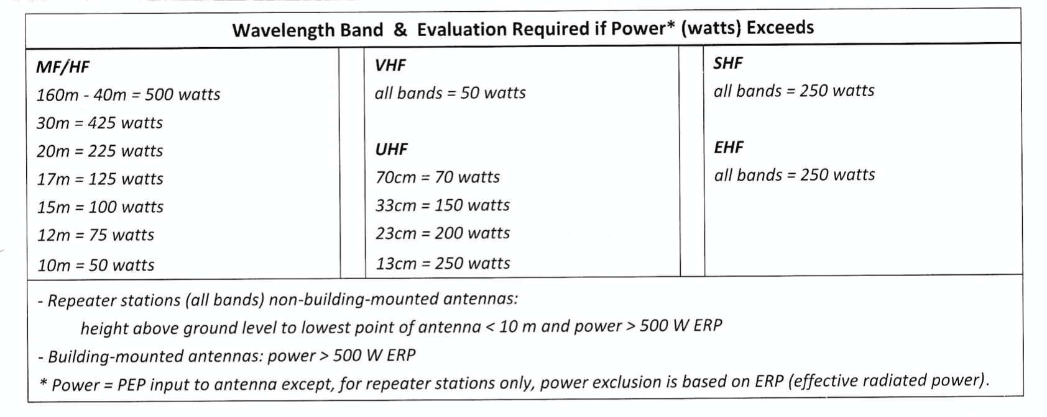
FCC Section 97.13(c)

Slide 6
FCC Section 97.13(c)
2. If the routine environmental evaluation indicates that the RF electromagnetic fields could exceed the limits contained in Section 1.1310 of this chapter in accessible areas, the licensee must take action to prevent human exposure to such RF electromagnetic fields. Further information on evaluating compliance with these limits can be found in the FCC's OET Bulletin 65, "Evaluating Compliance with FCC- Specified Guidelines for Human Exposure to Radio Frequency Electromagnetic Fields"

Slide 7
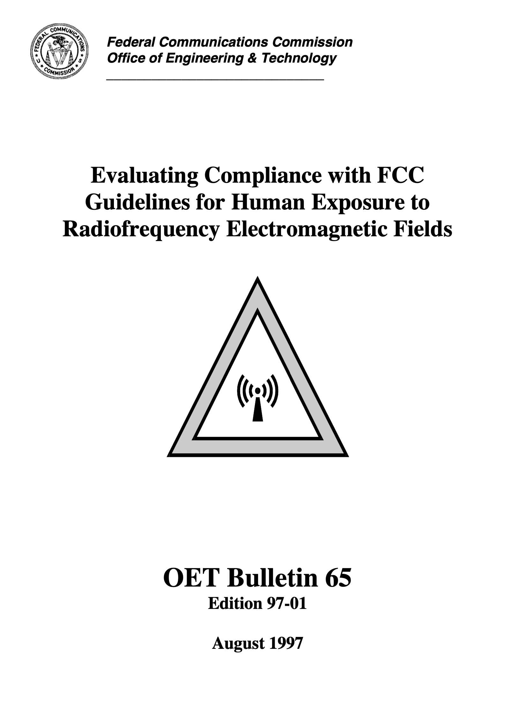
OET Bulletin 65 is downloadable from the internet
http://www.fcc.gov/oet/rfsafety
Supplement A – Additional Information for Commercial Radio Stations
Supplement B – Additional Information for Amateur Radio stations

Slide 8
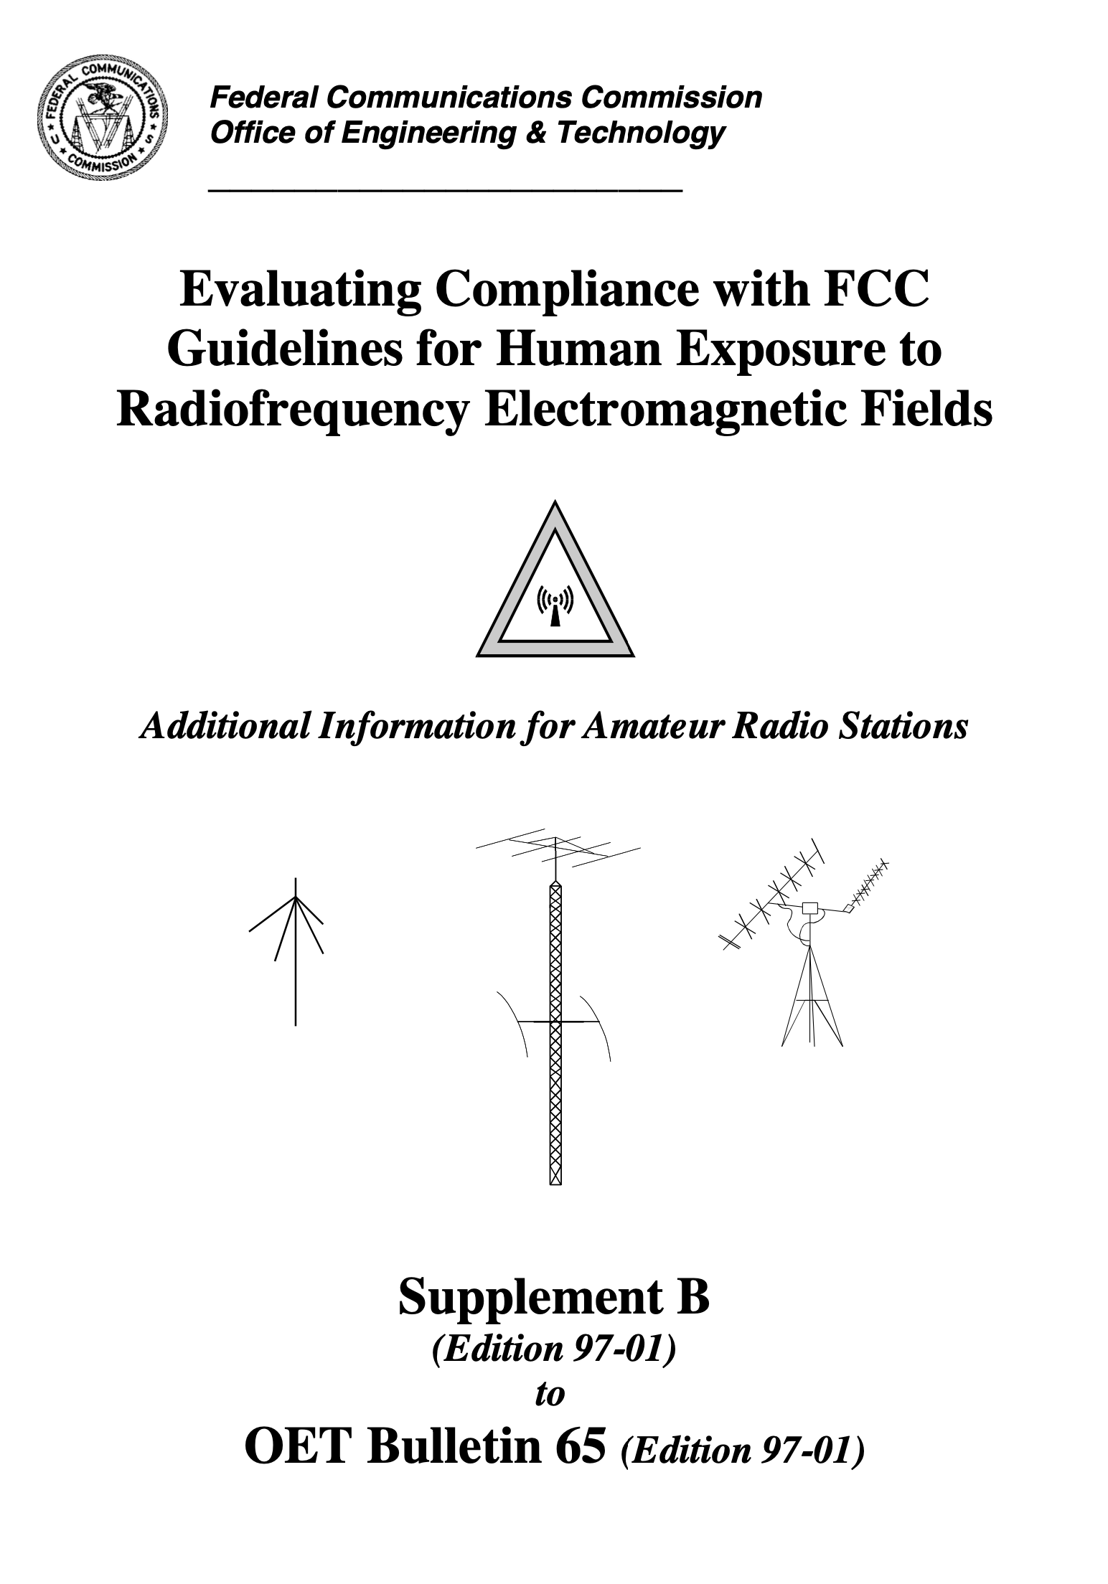
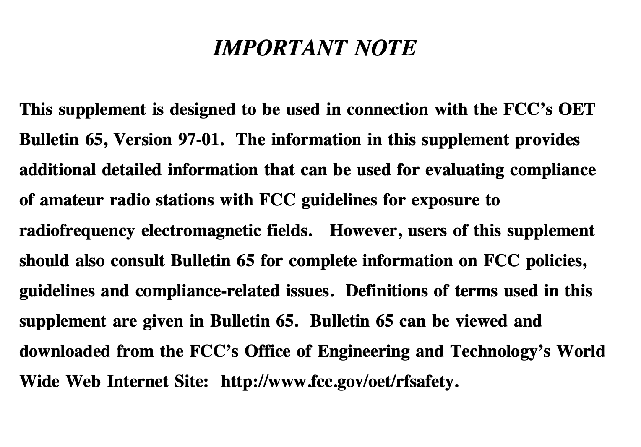

Slide 9
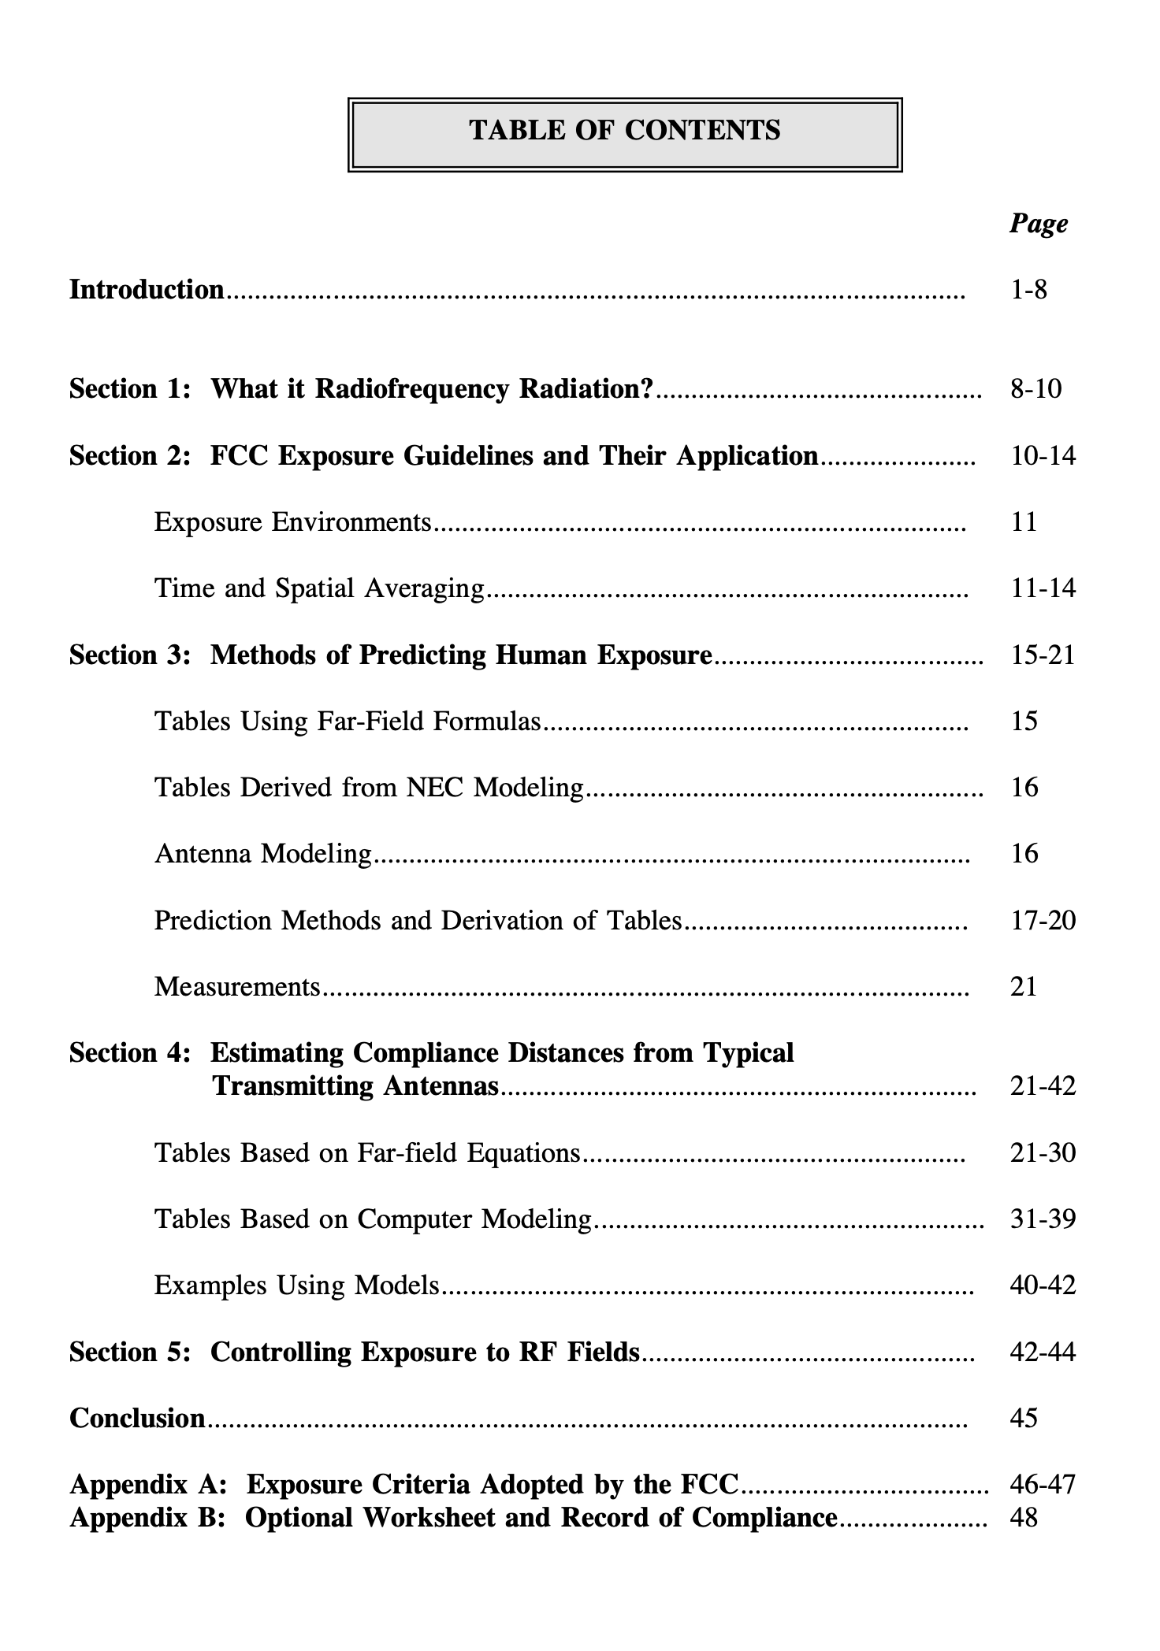
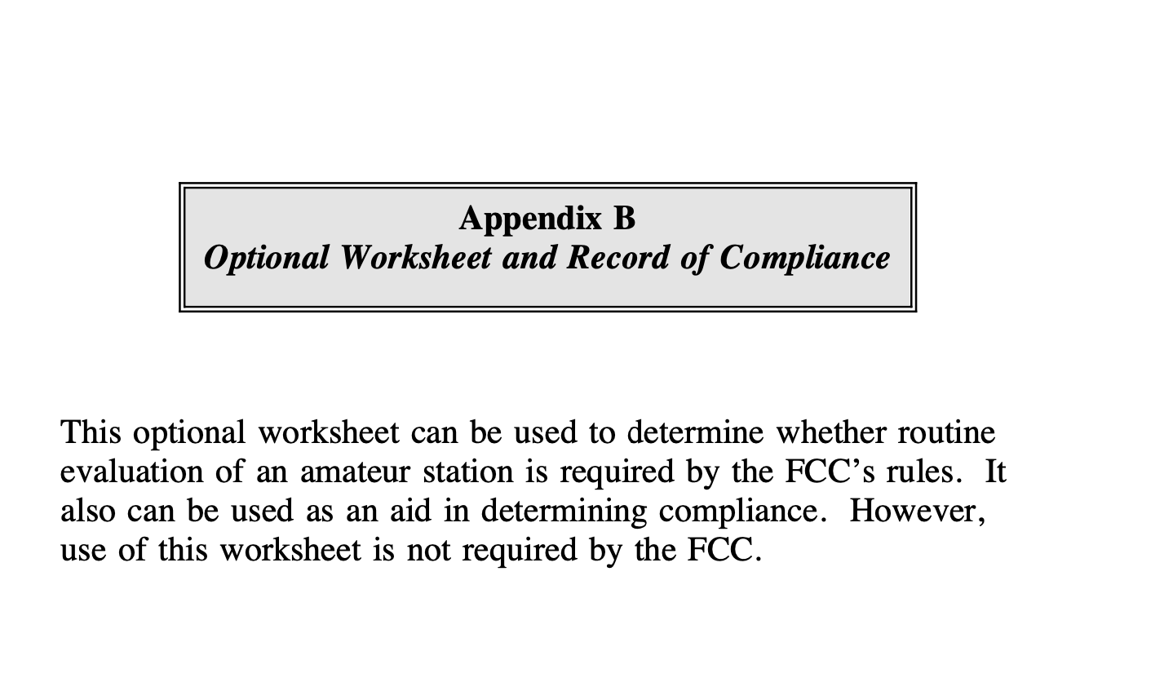

Slide 10
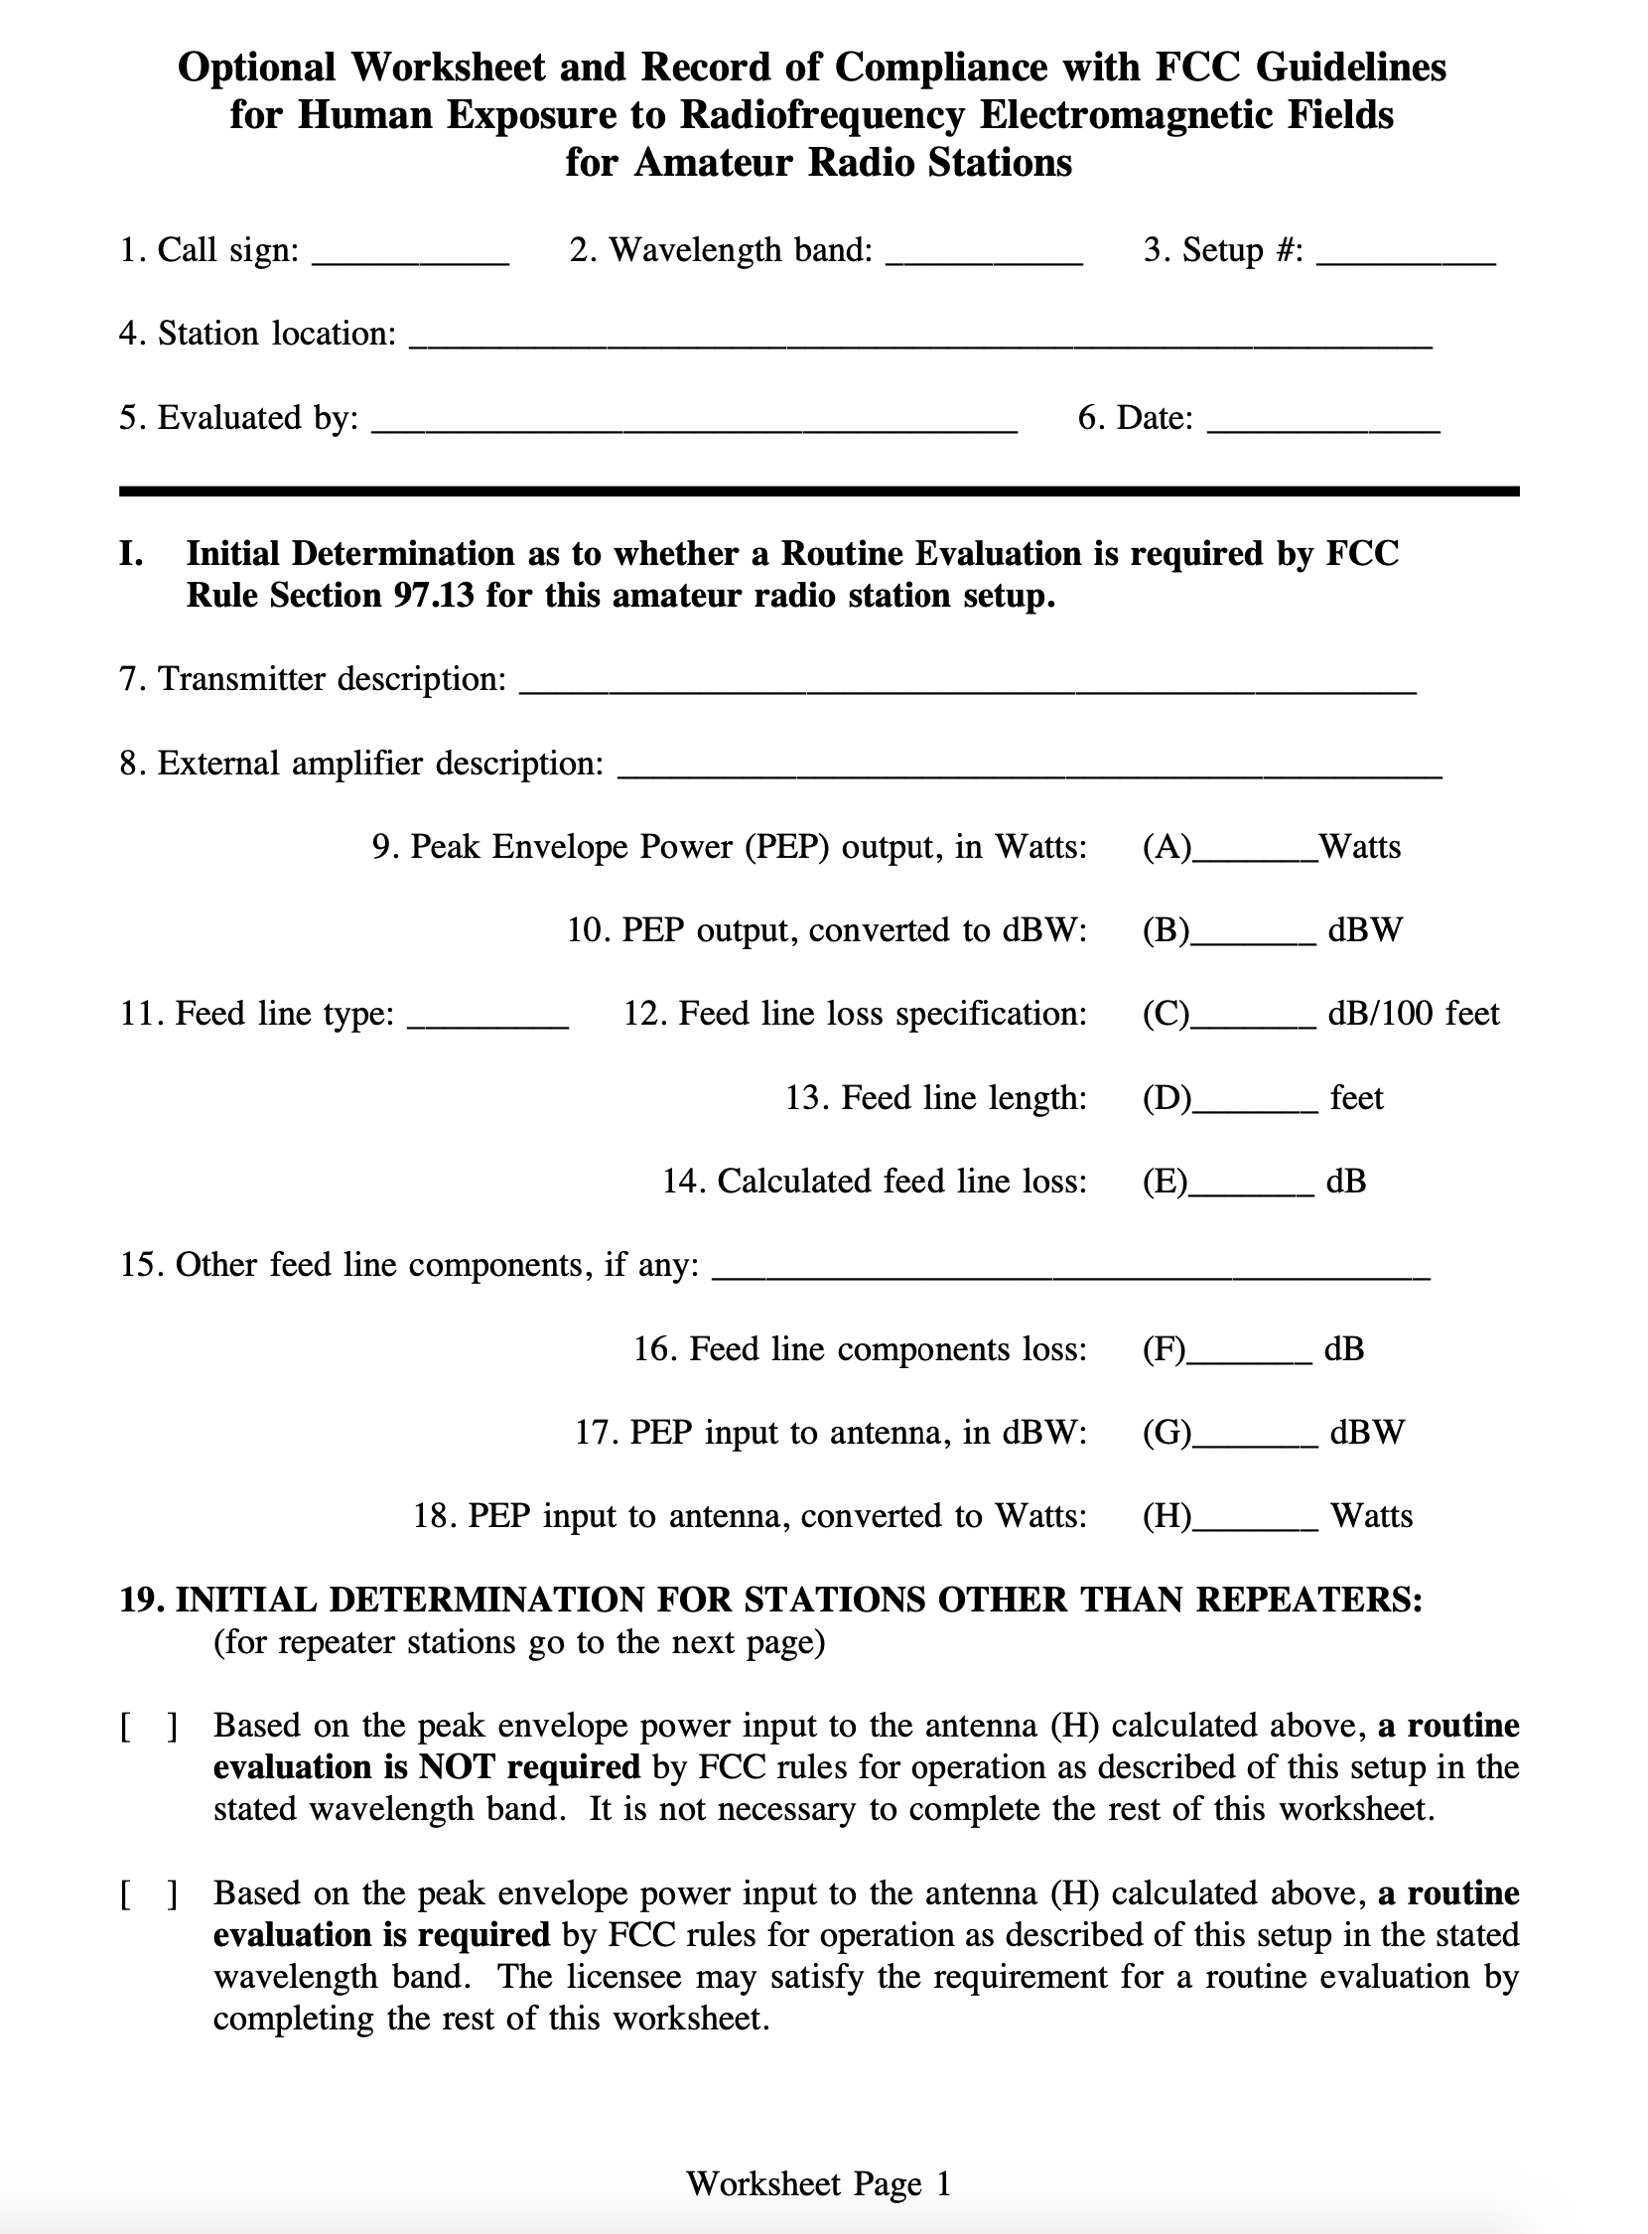
Initial Determination
(Do I need to do an exposure evaluation)
List transmitter model.
List external amplifier if any.
List Power (PEP) from radio and/or amplifier specifications.
Convert PEP watts to dBW.
Identify feedline type and loss specification (per 100 ft).
Measure or calculate feedline length.
Calculate feedline loss.
Identify and calculate other feedline components and their losses.
Calculate PEP to antenna in dBW.
Convert dBW to watts.
Compare to FCC table and determine if exposure analysis is required.

Slide 11
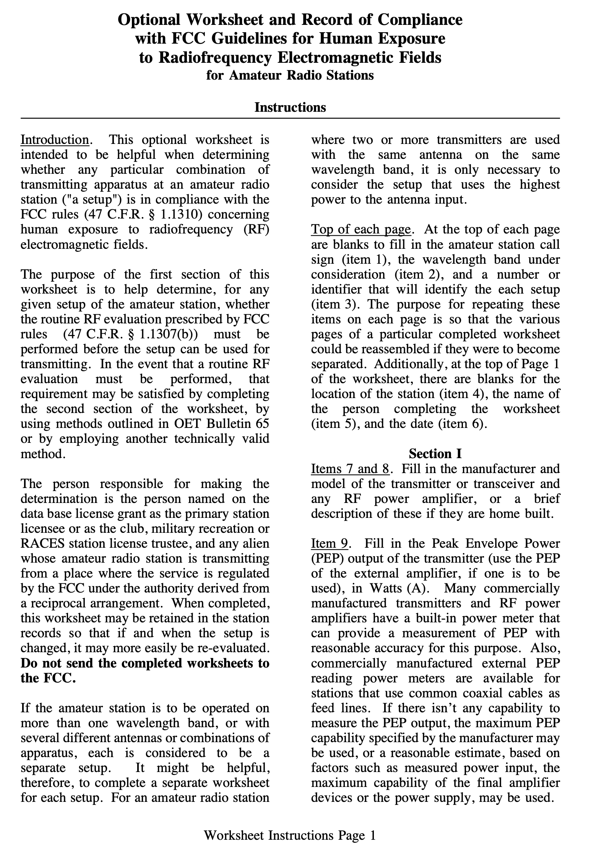
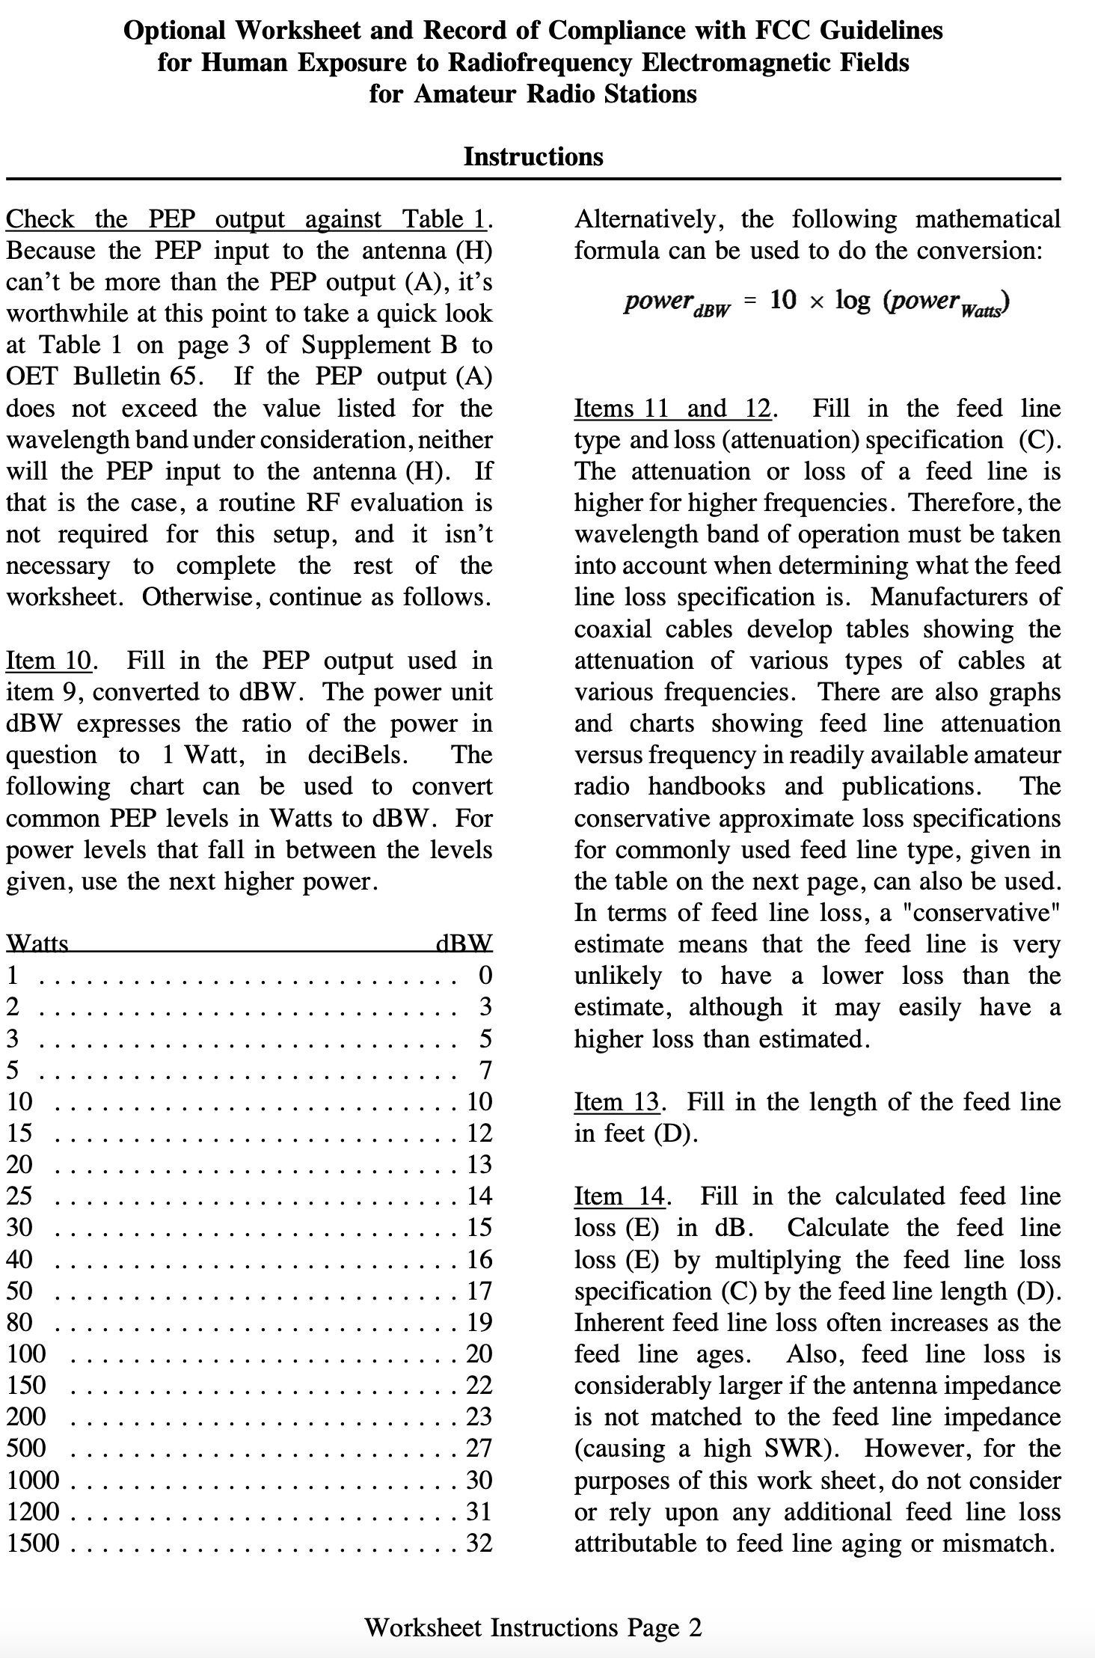

Slide 12
Information Needed
PEP from Transmitter Specifications
PEP from Amplifier Specification (If Applicable)
Antenna Band Coverage
Feedline Cable Length
Feedline Cable Type and Manufacturer
Feedline Cable Loss Specification

Slide 13
First Steps
Determine power capabilities of your transceiver.
What bands does your antenna/antennas support.
Identify the bands that may require evaluation.

Slide 14
My Radio
Flex 6600 M
100 watts PEP on 180 Meters thru 6 Meters
My Antenna
Hy Power 40 Meter OCF
Covers 40M, 20M, 10M, 6M and 2 M
Conclusion:
Must evaluate 10M and 6M.

Slide 15
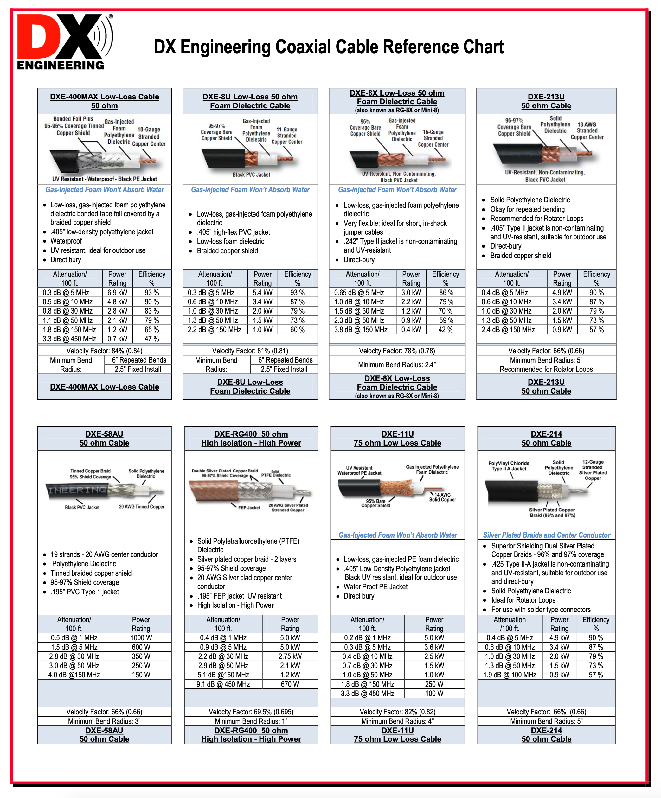

Slide 16
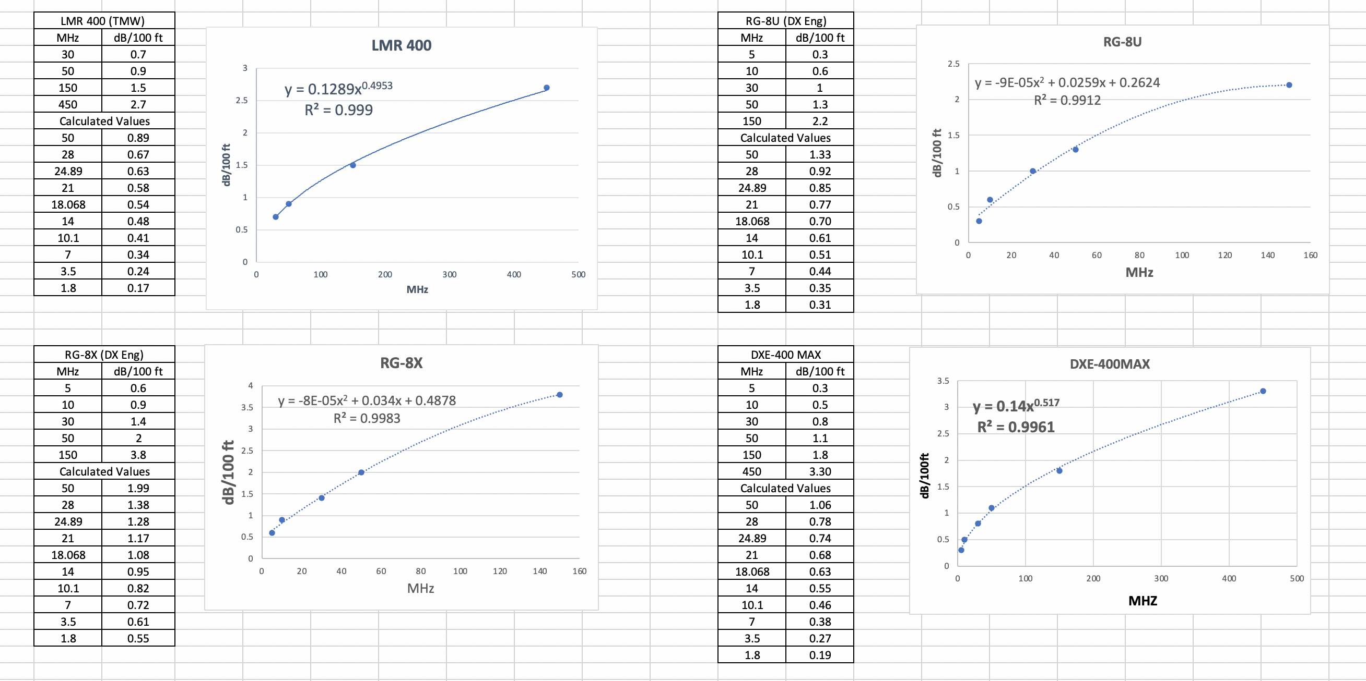

Slide 18
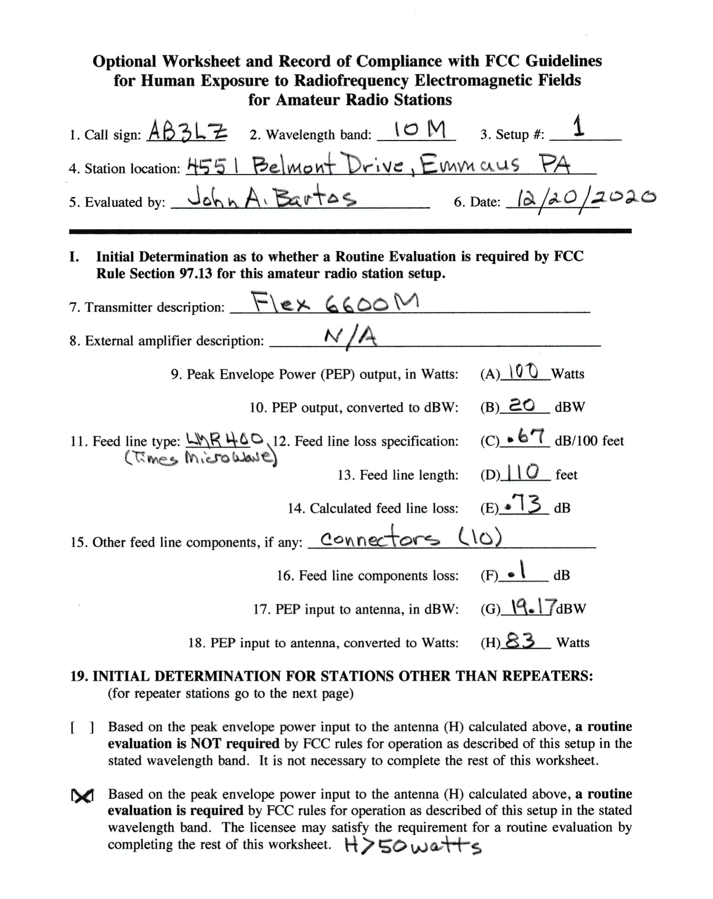
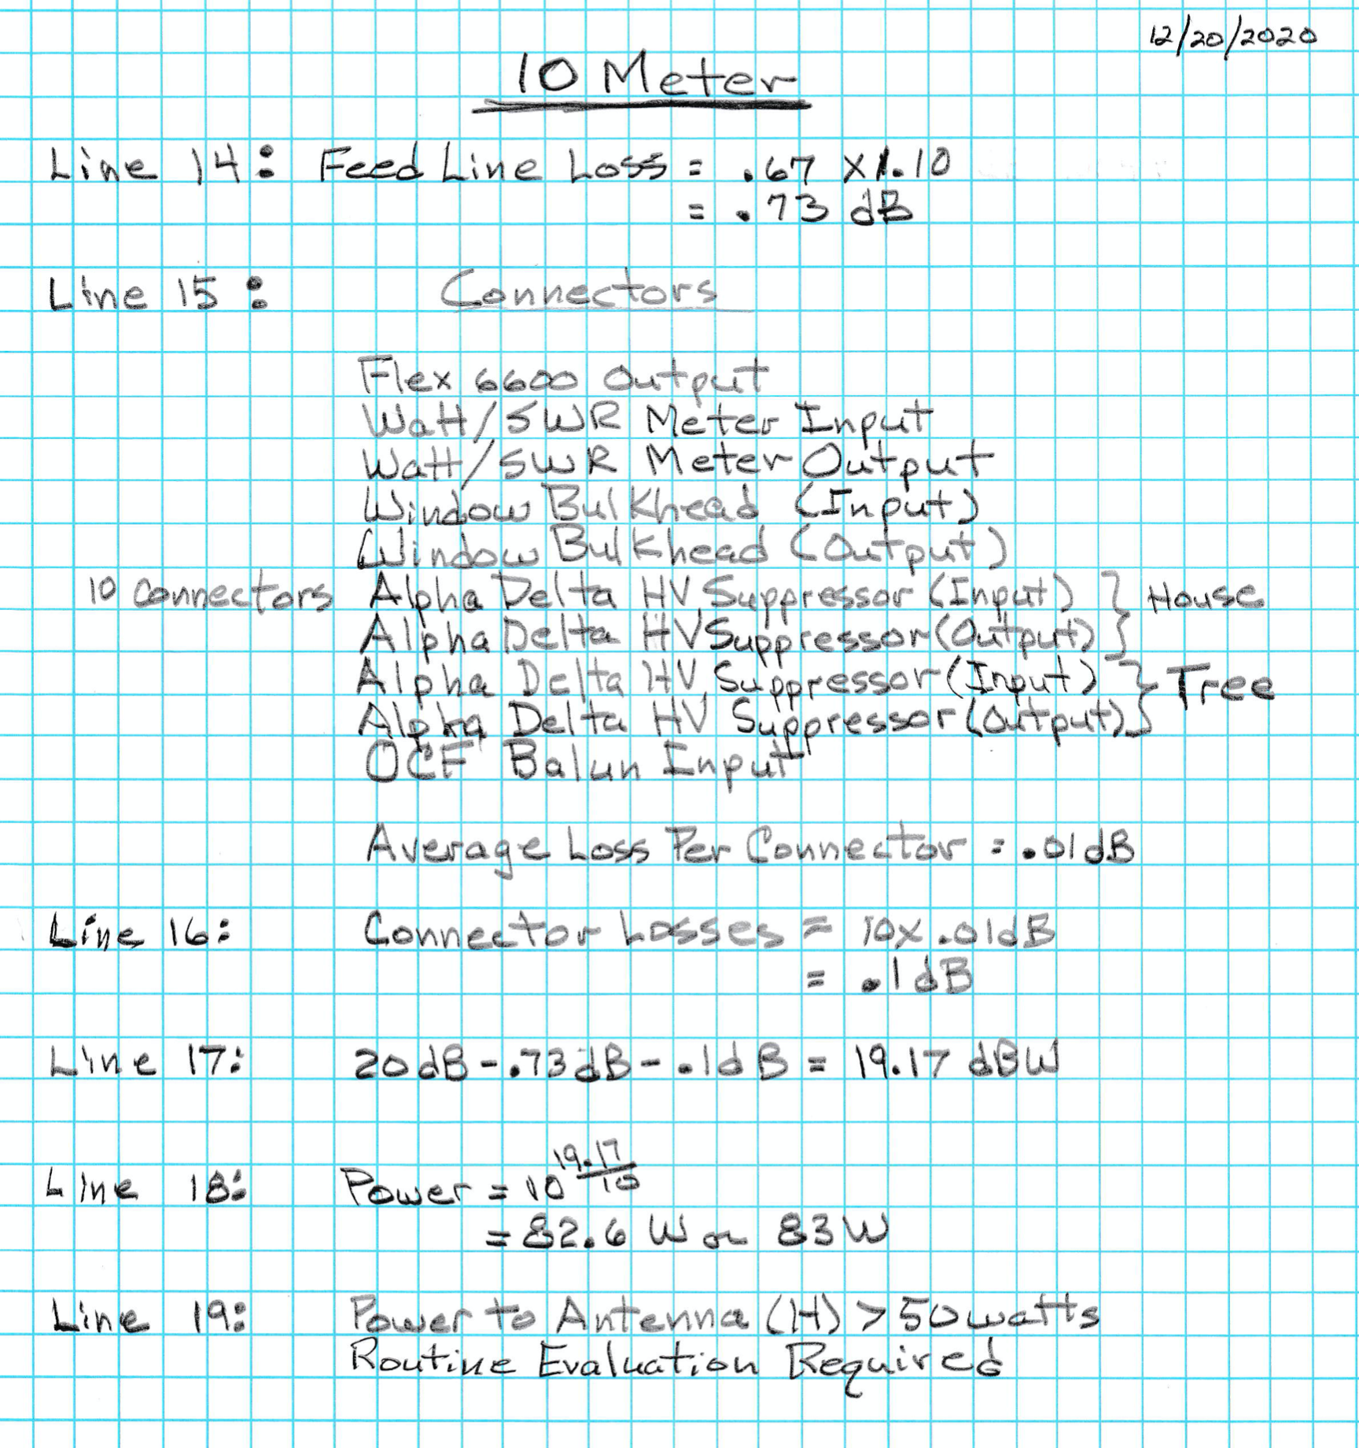

Slide 19
FCC Section 97.13(c)

Slide 20
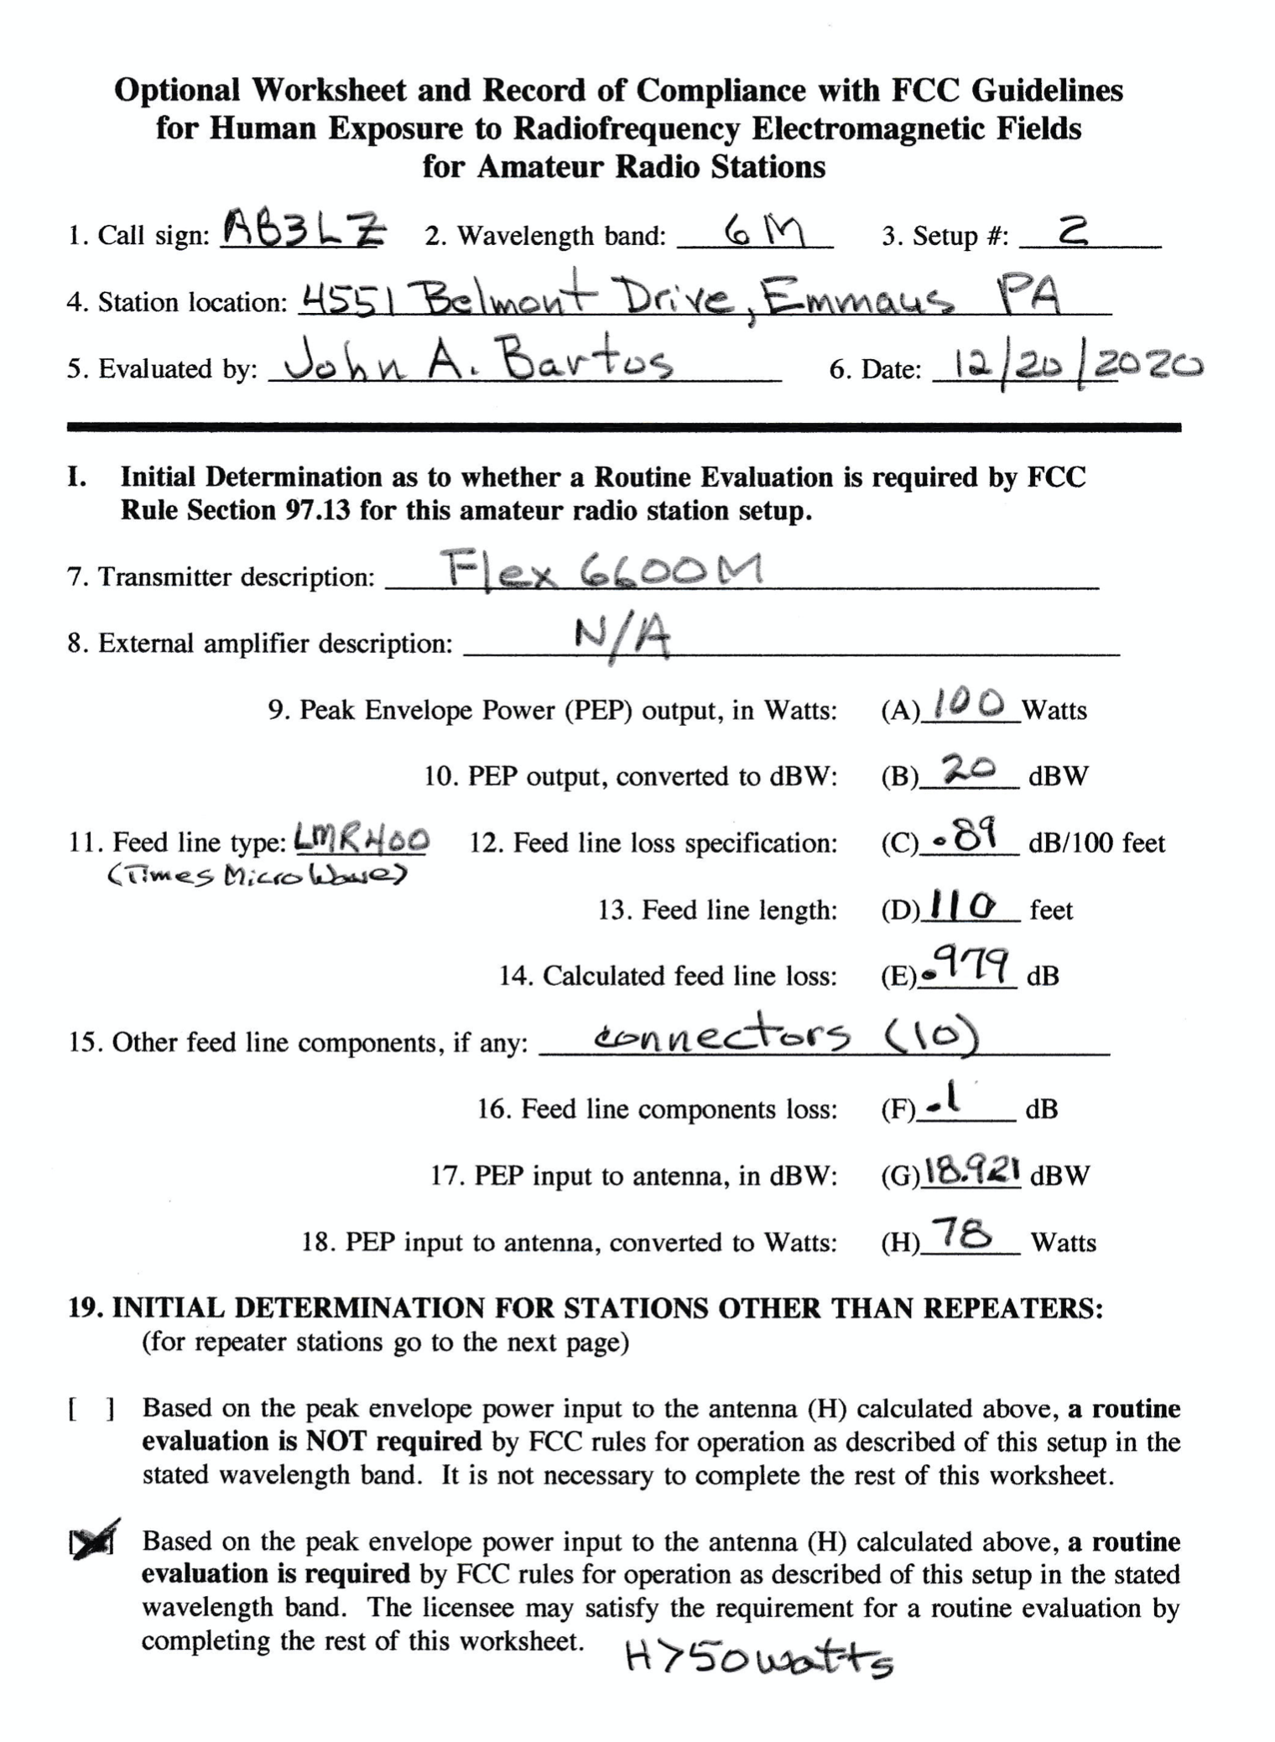
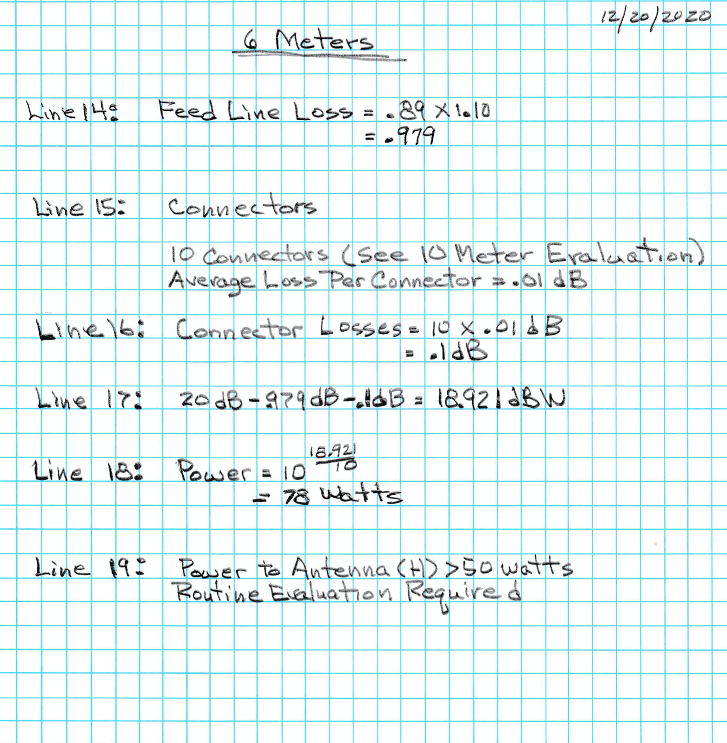

Slide 21
FCC Section 97.13(c)

Slide 22
To Be Continued
Questions?
Comments!

