Slide 1
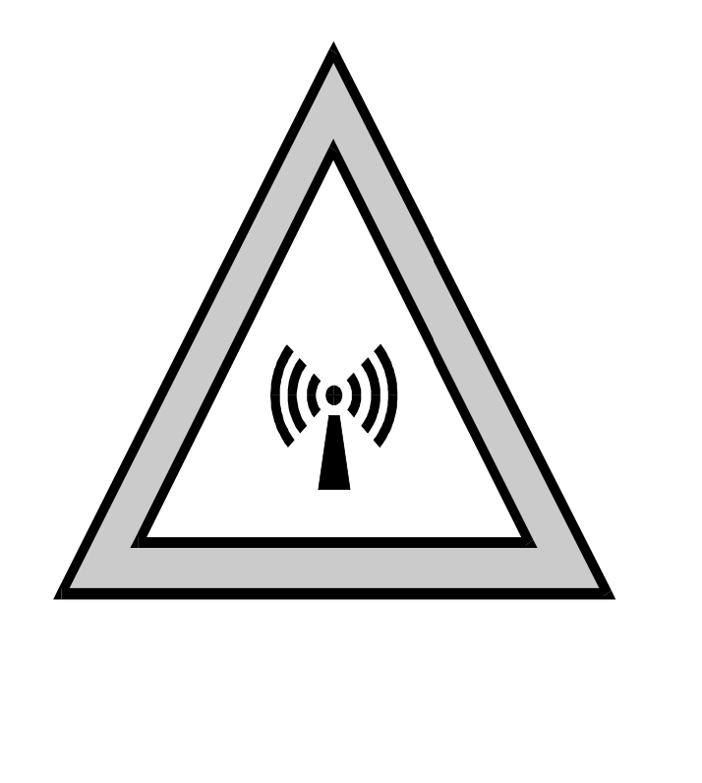
Evaluating Compliance with FCC Guidelines for Human Exposure to Radiofrequency Electromagnetic Fields
(Part 2)

Slide 2
FCC Section 97.13(c)
Before causing or allowing an amateur station to transmit from any place where the operation of the station could cause human exposure to RF electromagnetic field levels in excess of those allowed under Section 91.1310 of this chapter, the licensee is required to take certain actions.
1. The licensee must perform the routine RF environmental evaluation prescribed by Section 91.1307(b) of this chapter, if the power of the licensee's station exceeds the limits given in the following table:

Slide 3
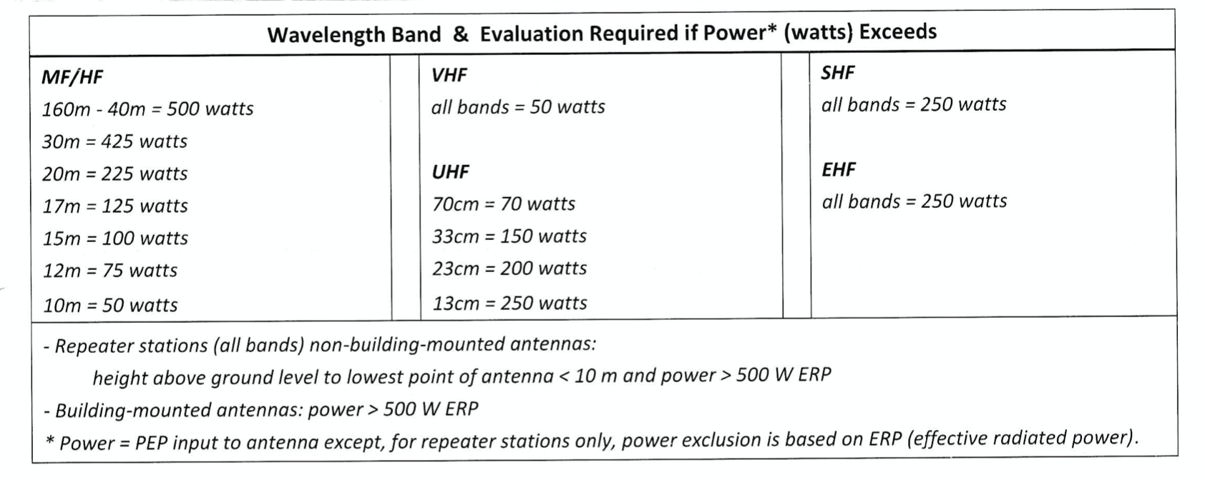
FCC Section 97.13(c)

Slide 4
FCC Section 97.13(c)
2. If the routine environmental evaluation indicates that the RF electromagnetic fields could exceed the limits contained in Section 1.1310 of this chapter in accessible areas, the licensee must take action to prevent human exposure to such RF electromagnetic fields. Further information on evaluating compliance with these limits can be found in the FCC's OET Bulletin 65, "Evaluating Compliance with FCC-Specified Guidelines for Human Exposure to Radio Frequency Electromagnetic Fields"

Slide 5
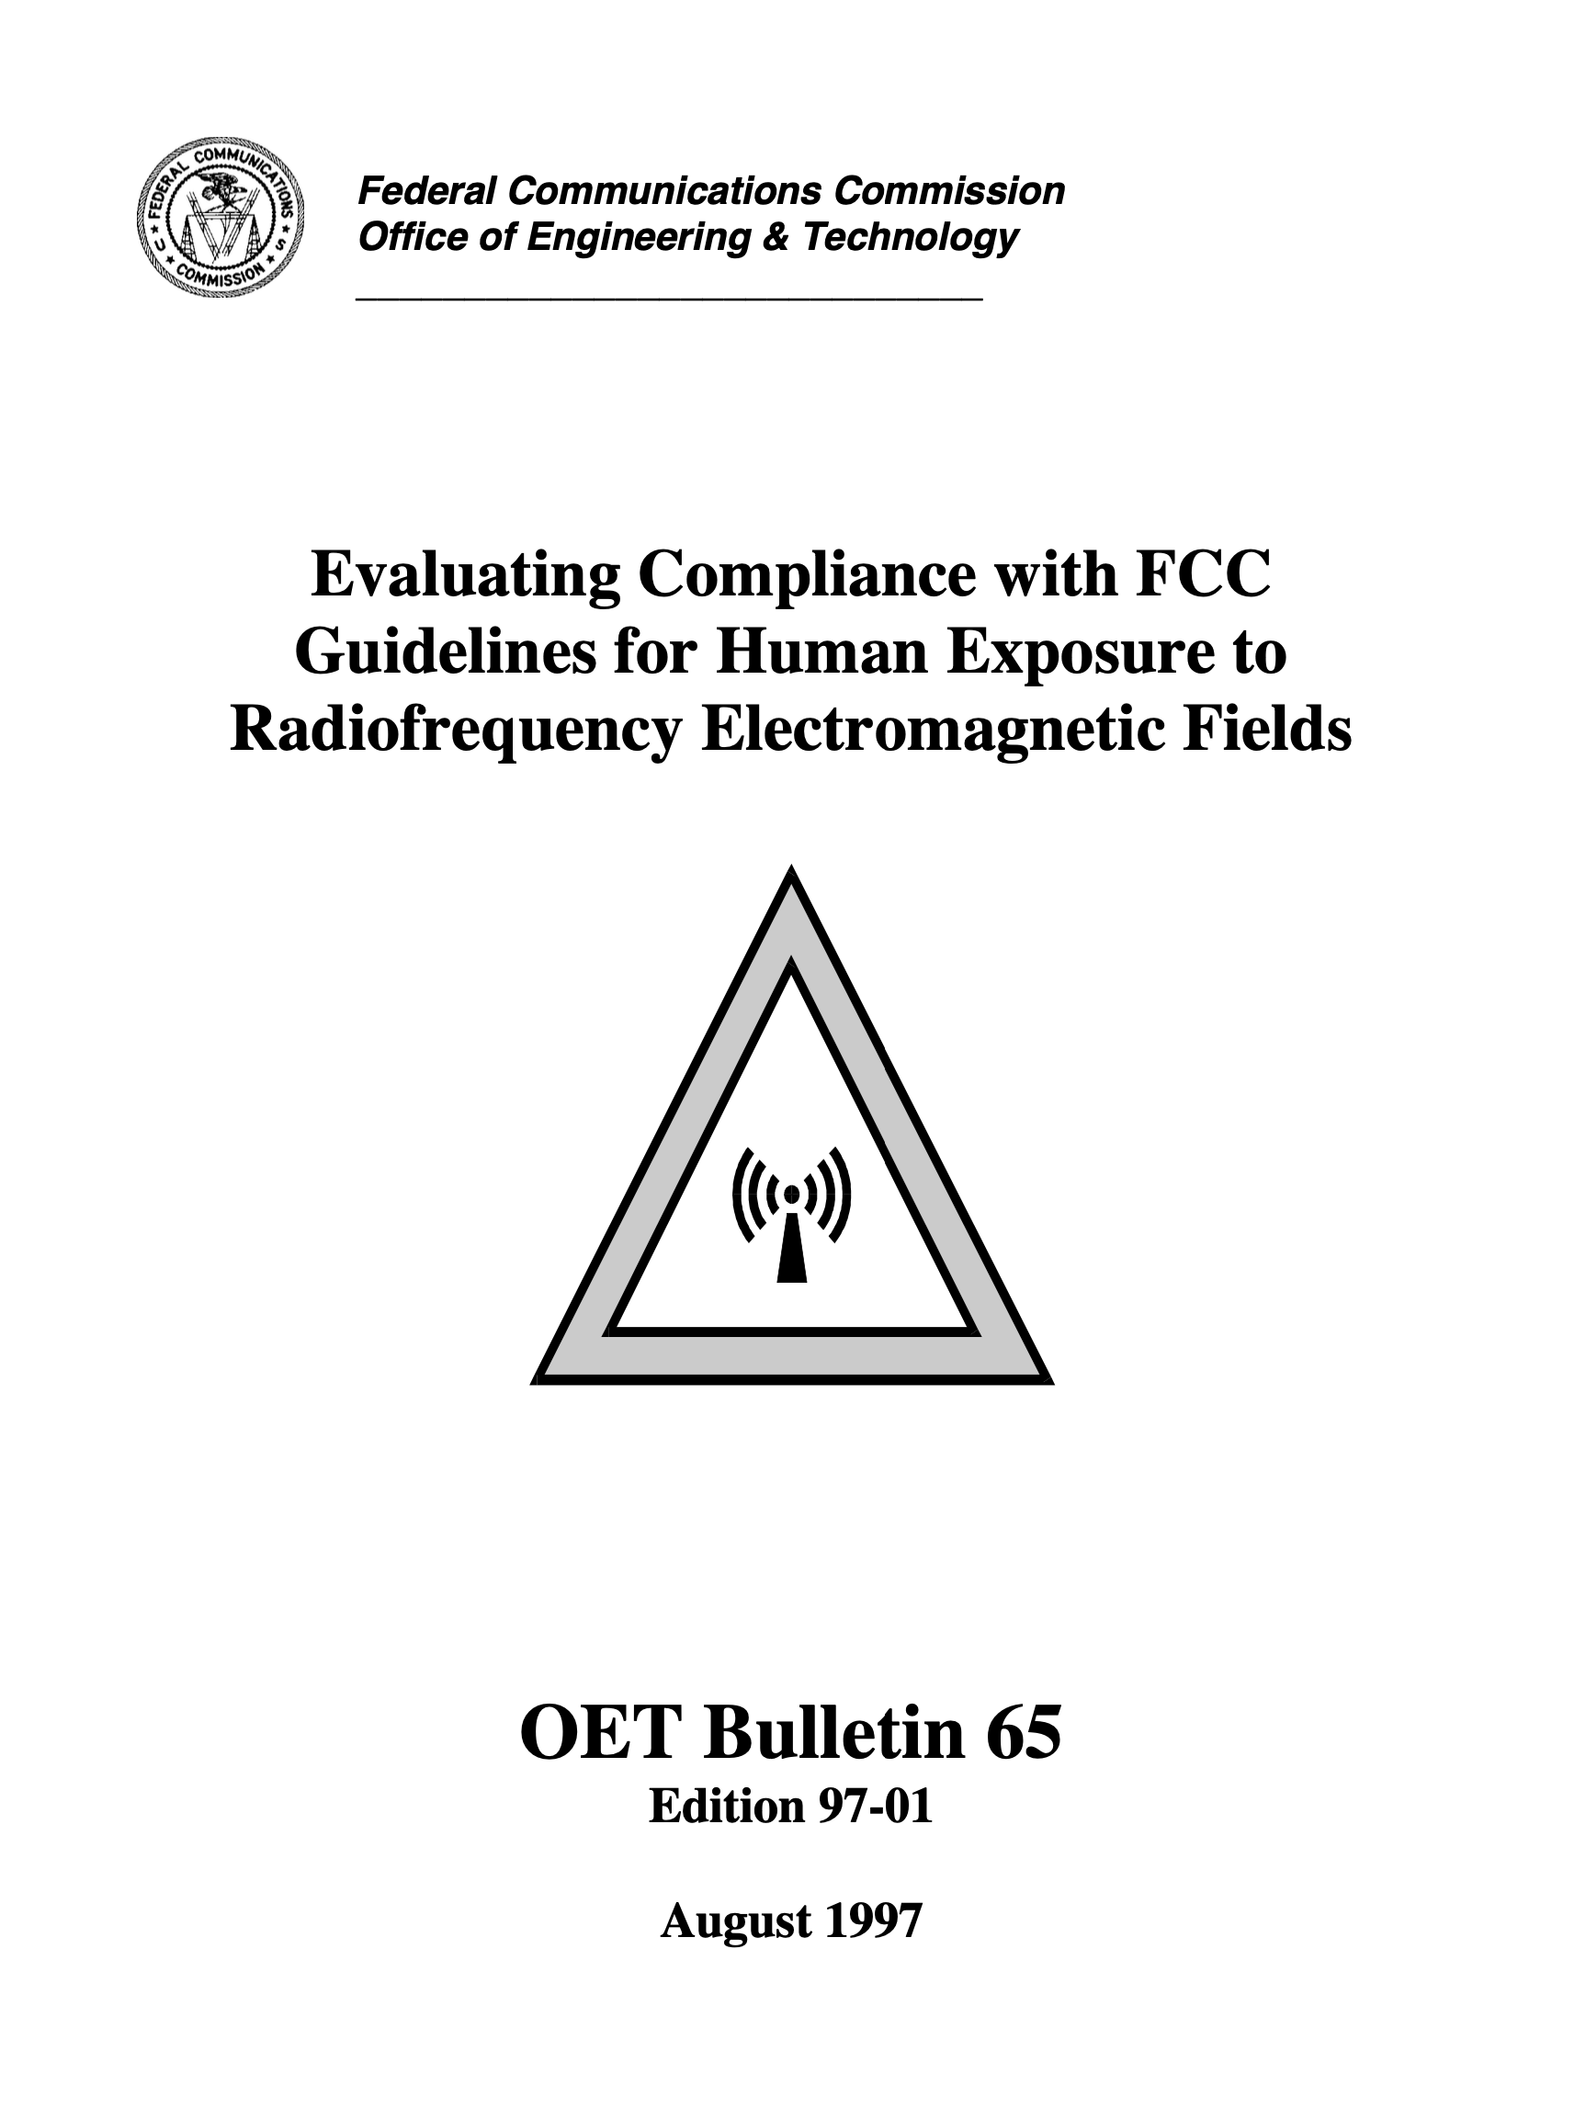
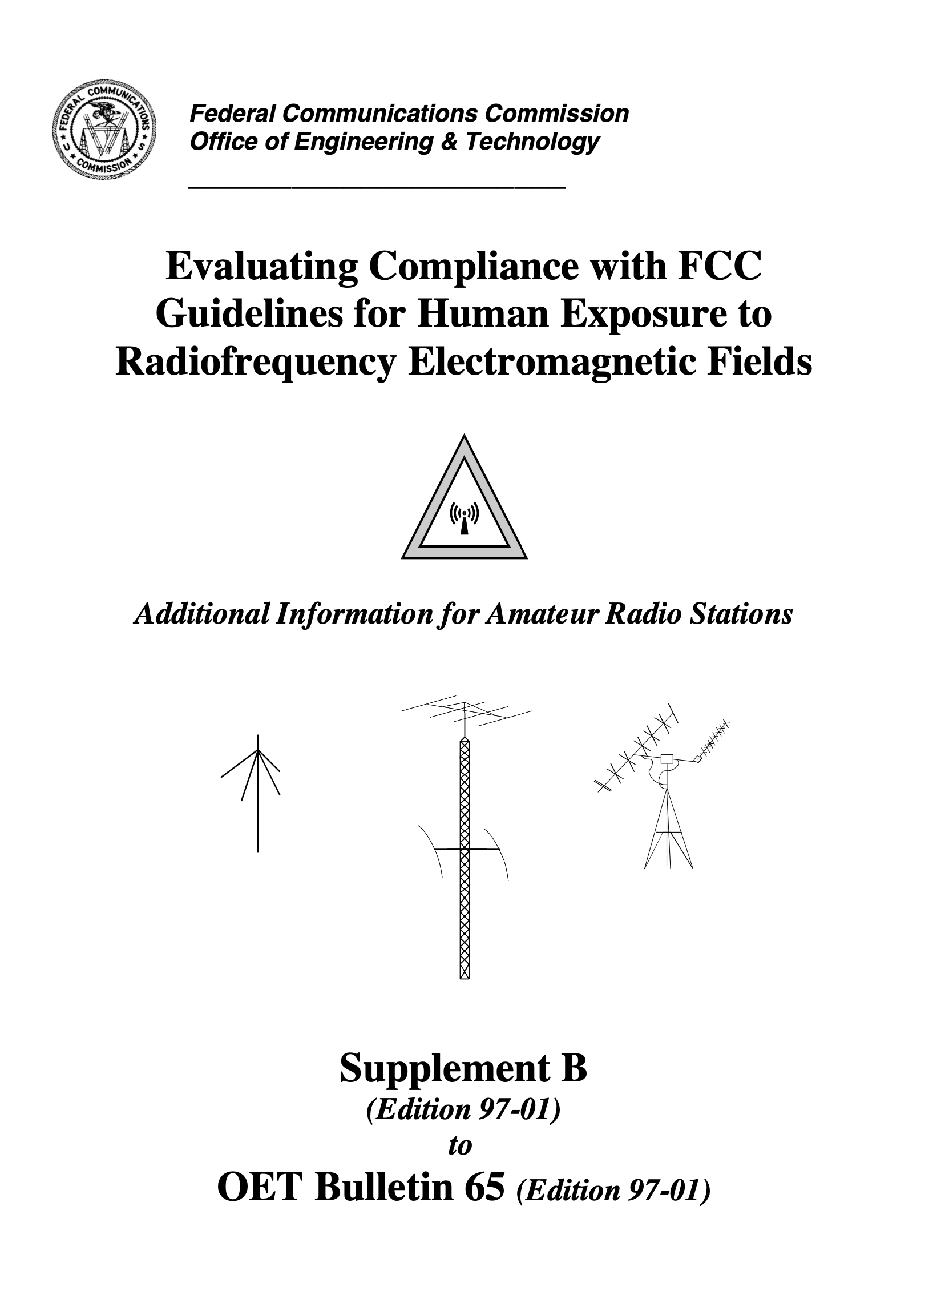

Slide 6
First Steps
Determine power capabilities of your transceiver.
What bands does your antenna/antennas support.
Identify the bands that may require evaluation.

Slide 7
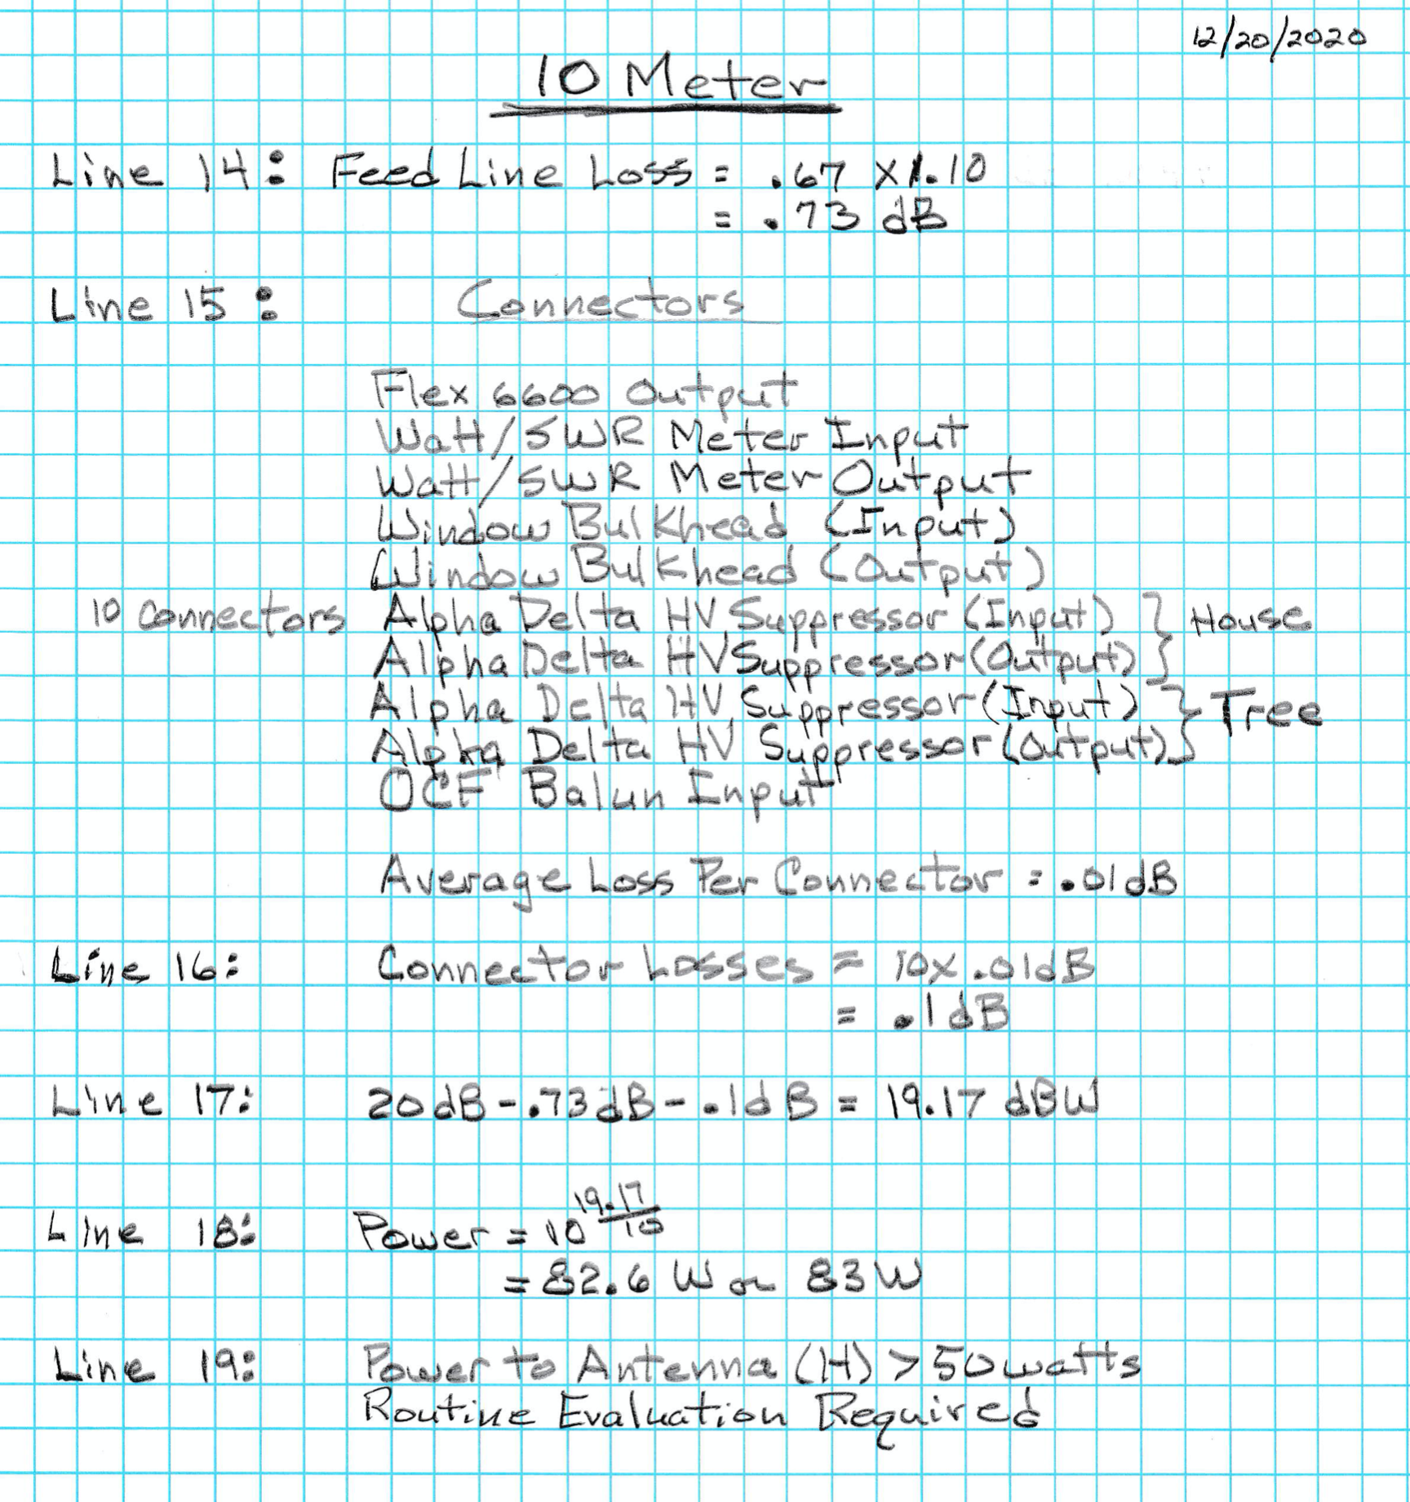
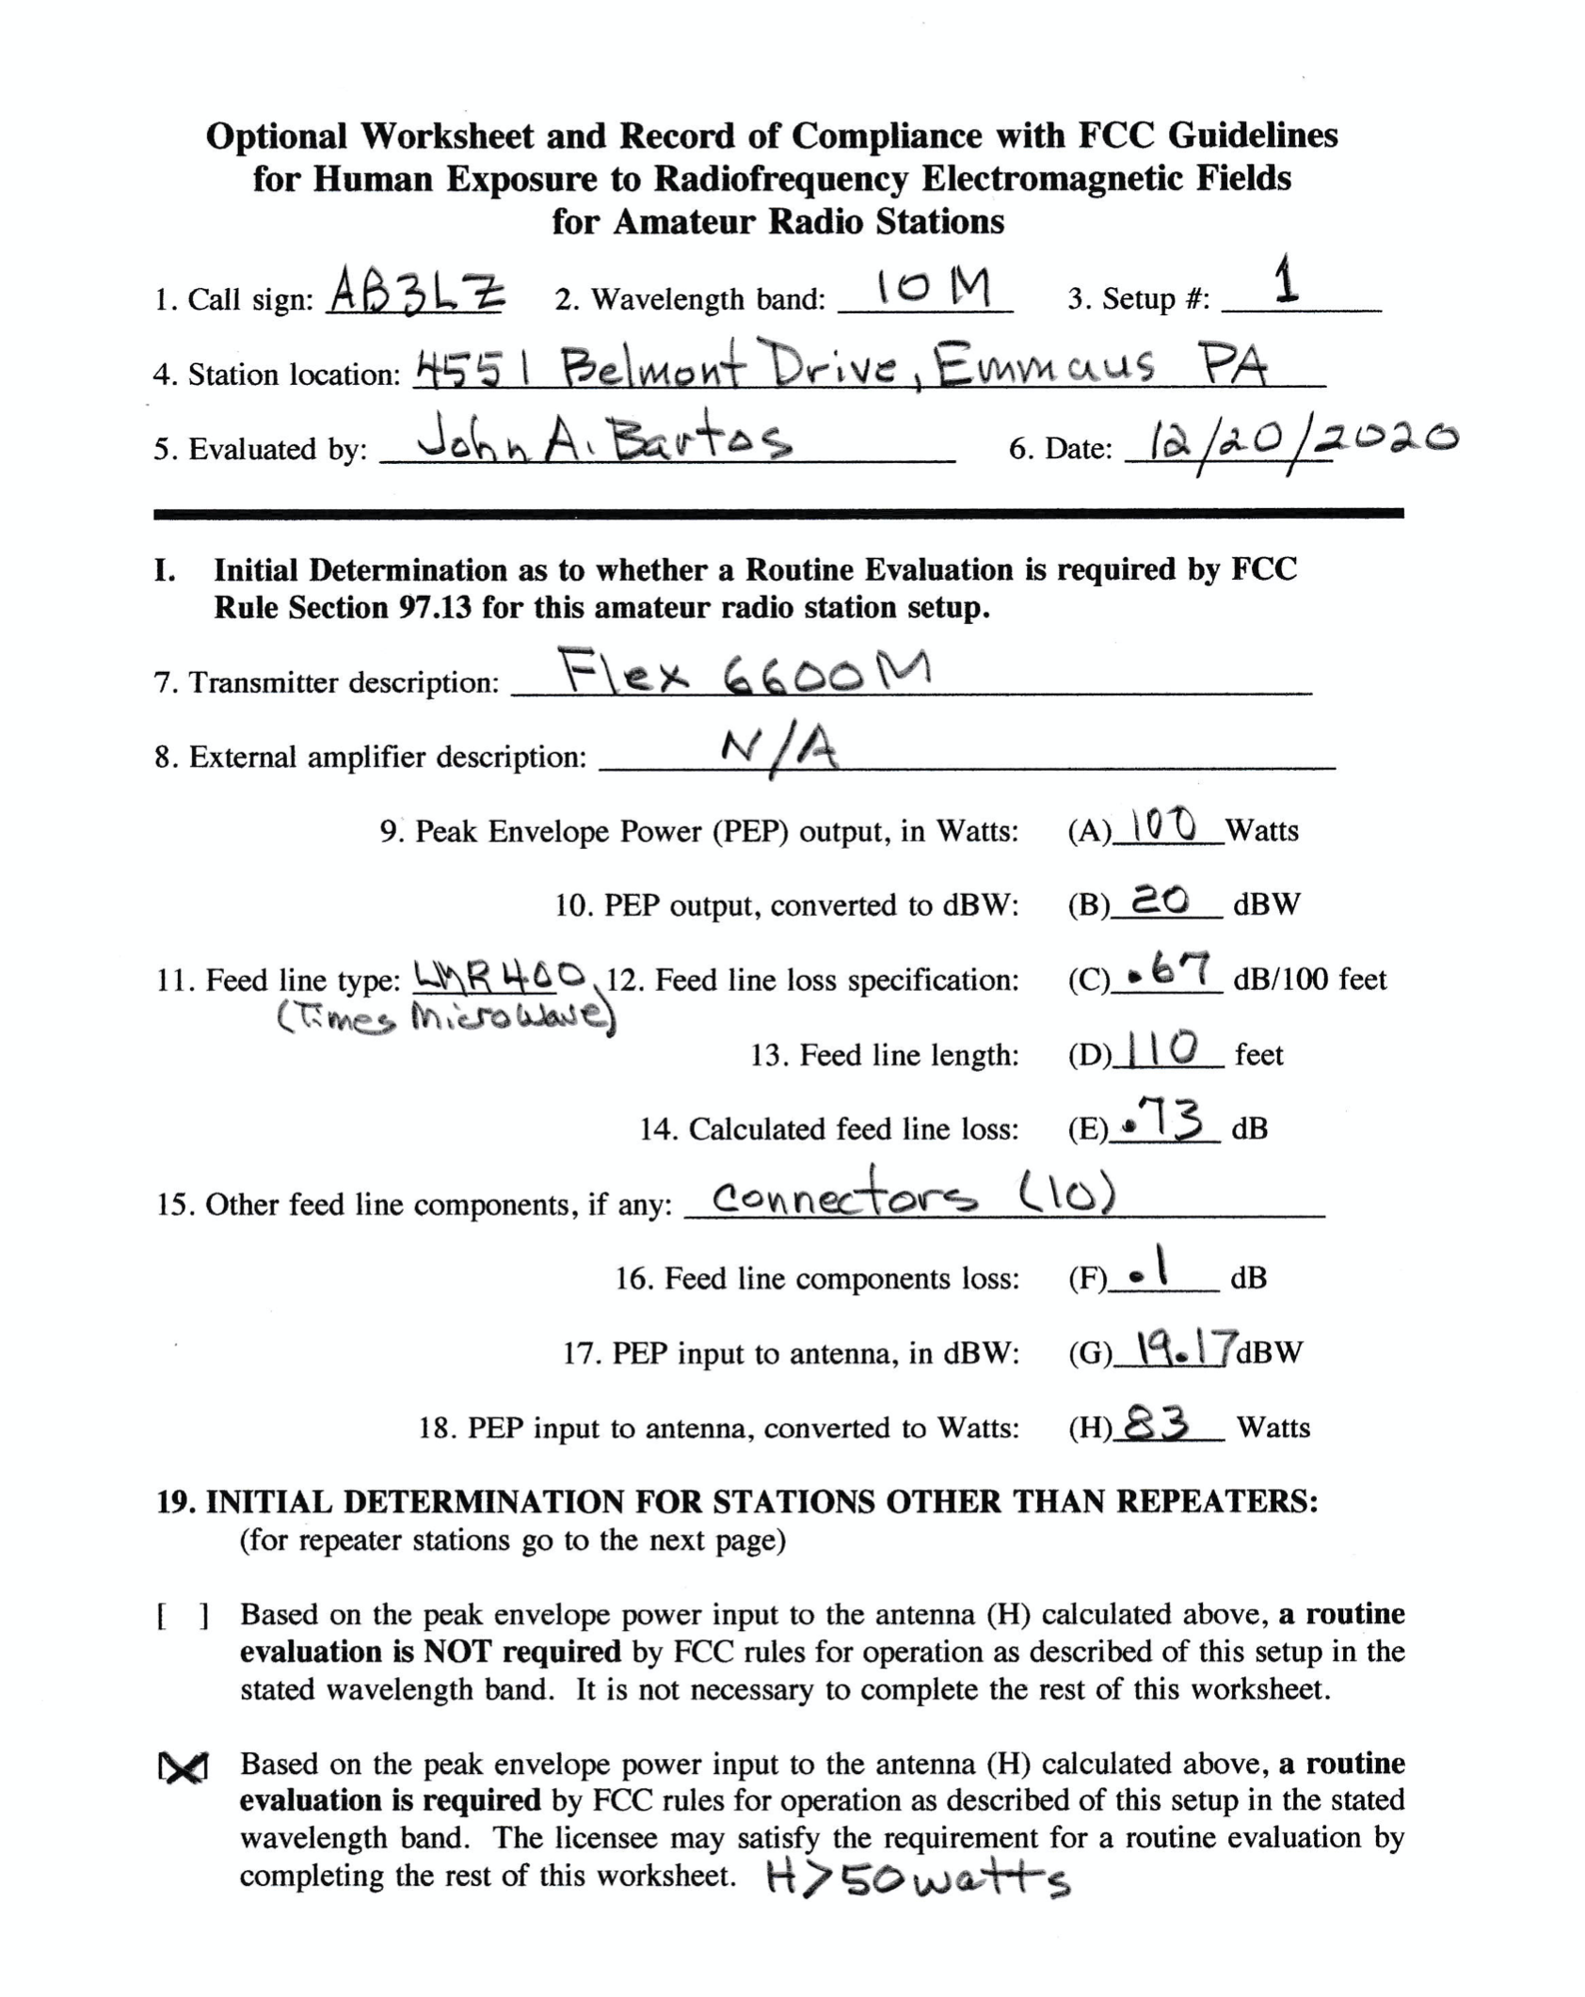

Slide 8
Detailed Evaluation
Evaluate Exposures:
  Radio Operator (Controlled Exposure)
  General Public (Uncontrolled Exposure)
Compare modeled minimum exposure distances to actual distances.
Compare calculated power flux density exposures to FCC limits.

Slide 9
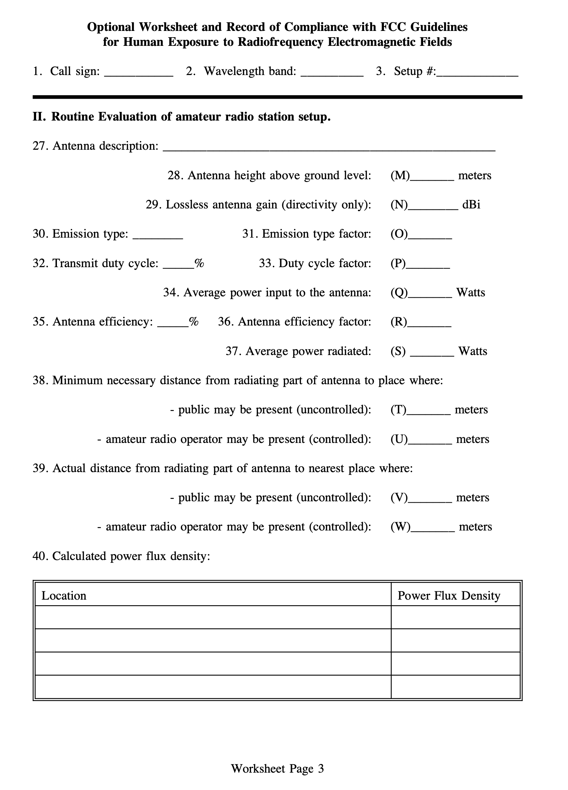
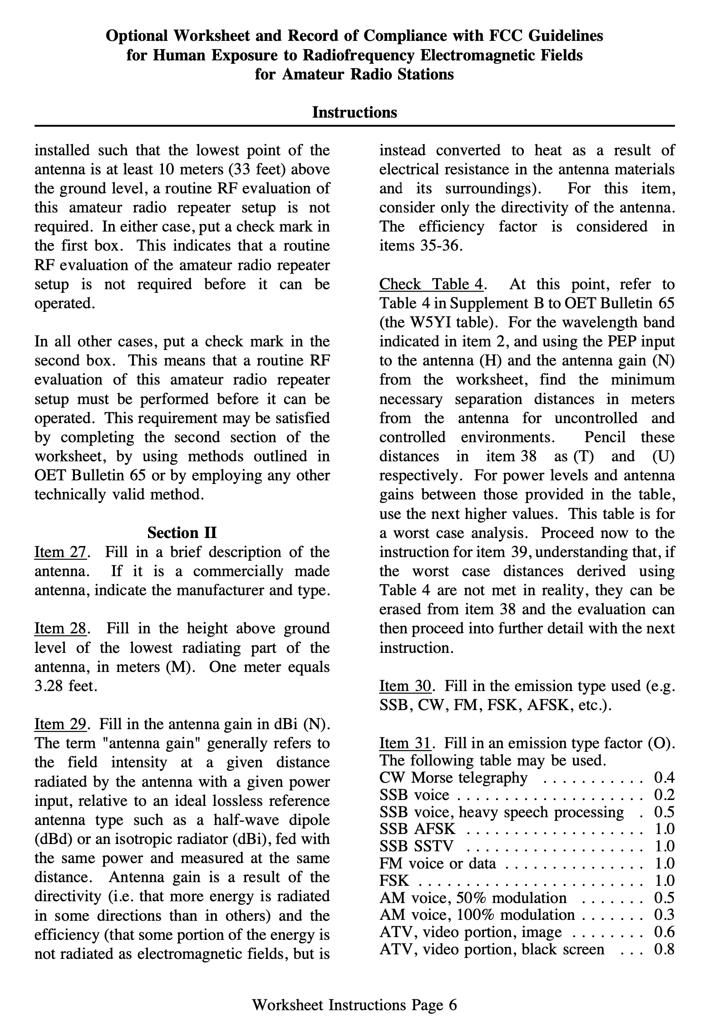

Slide 10
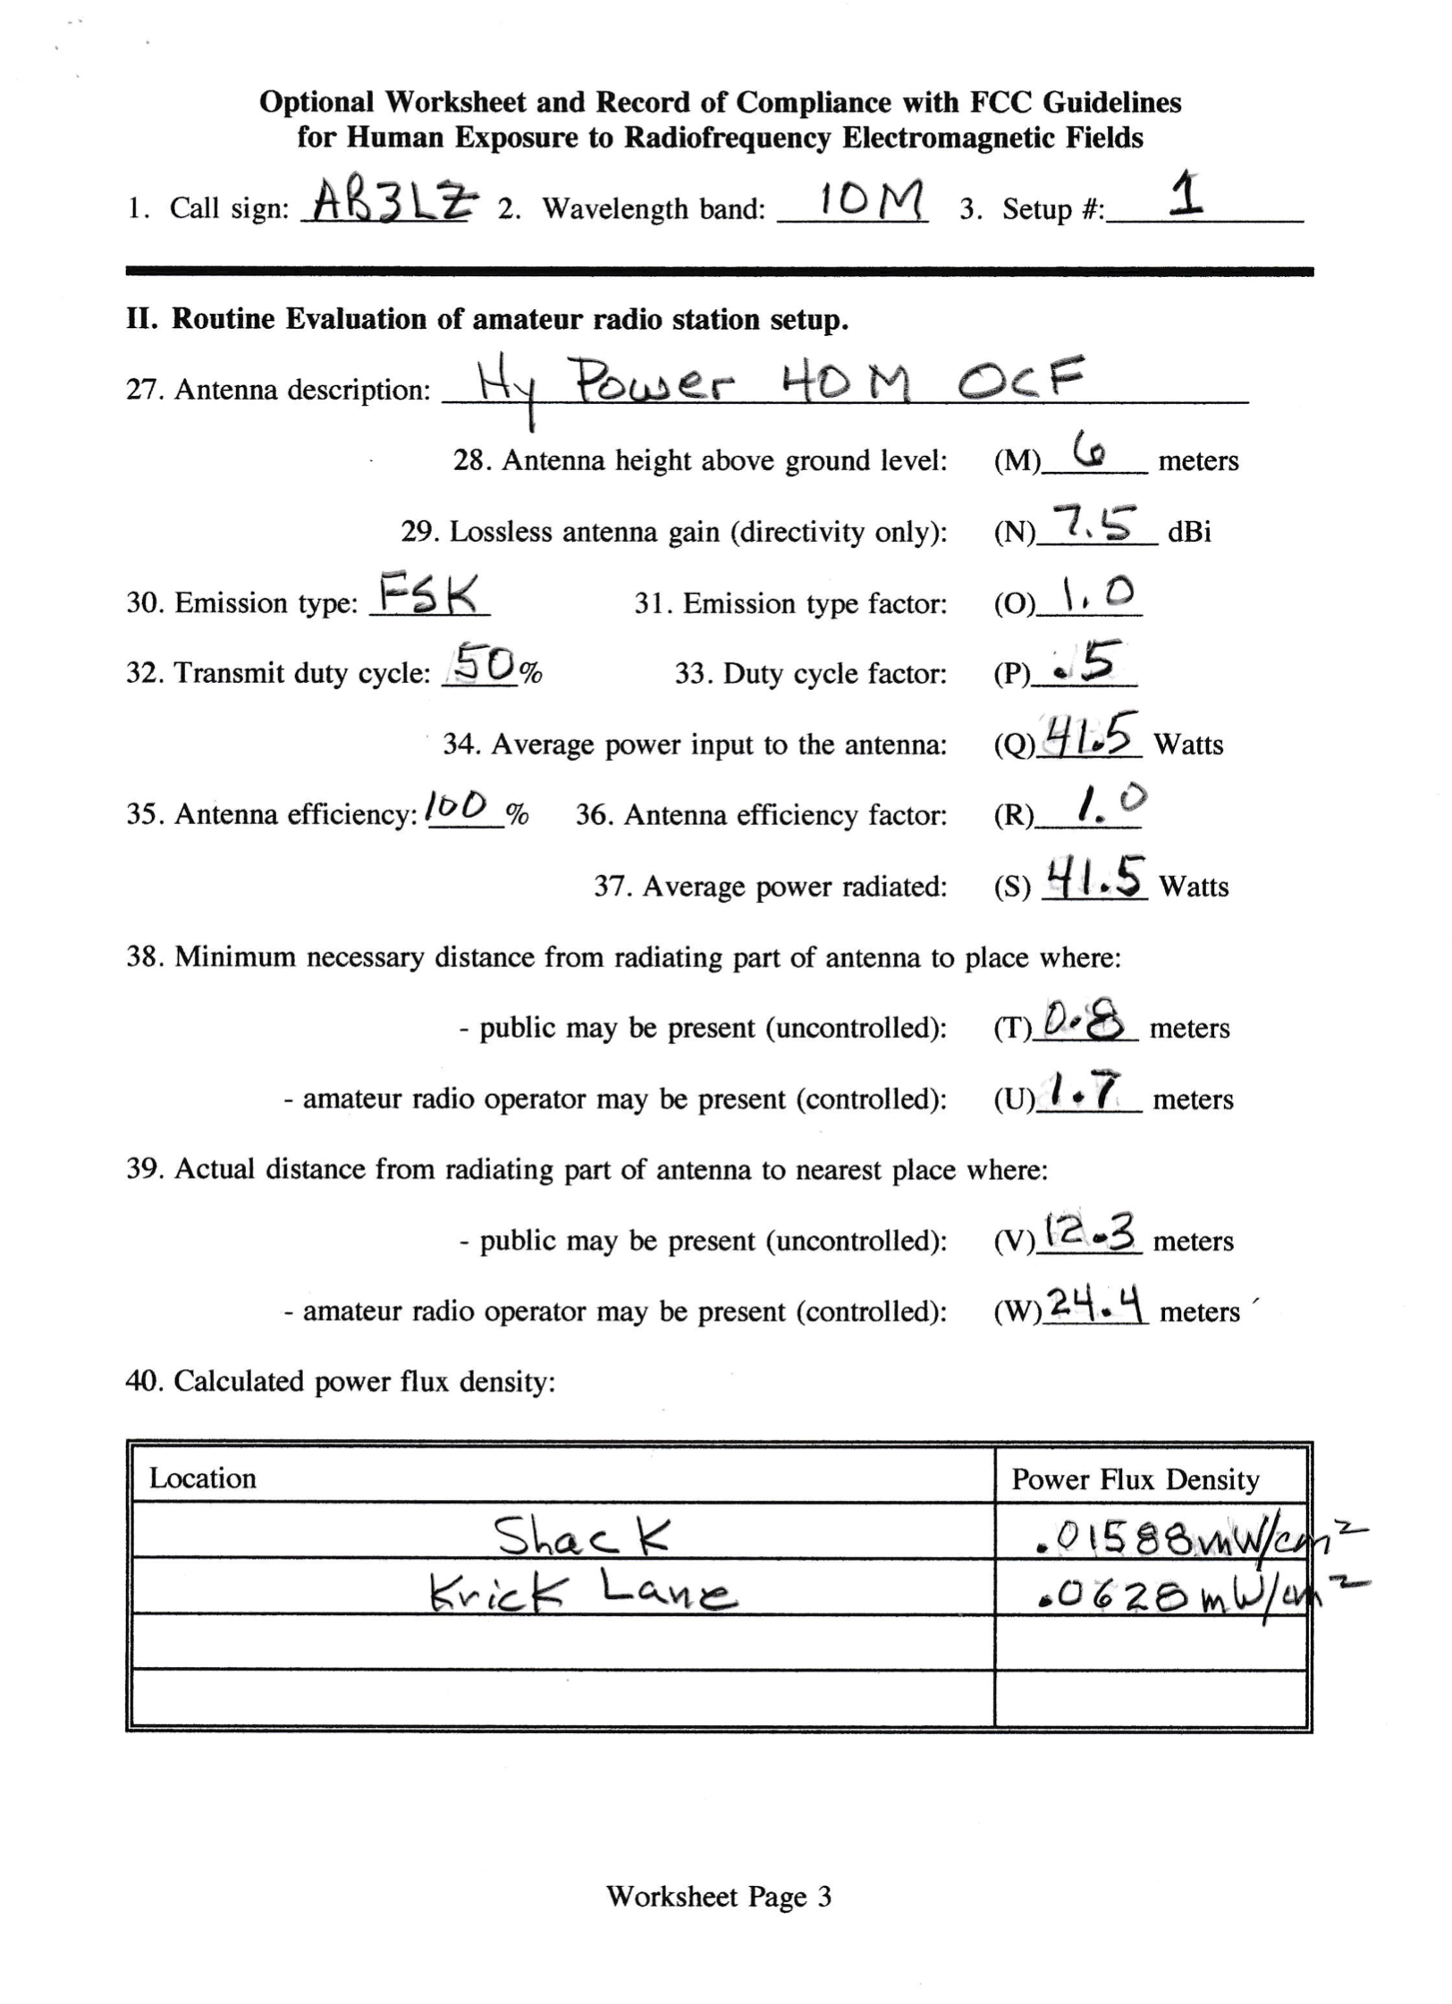
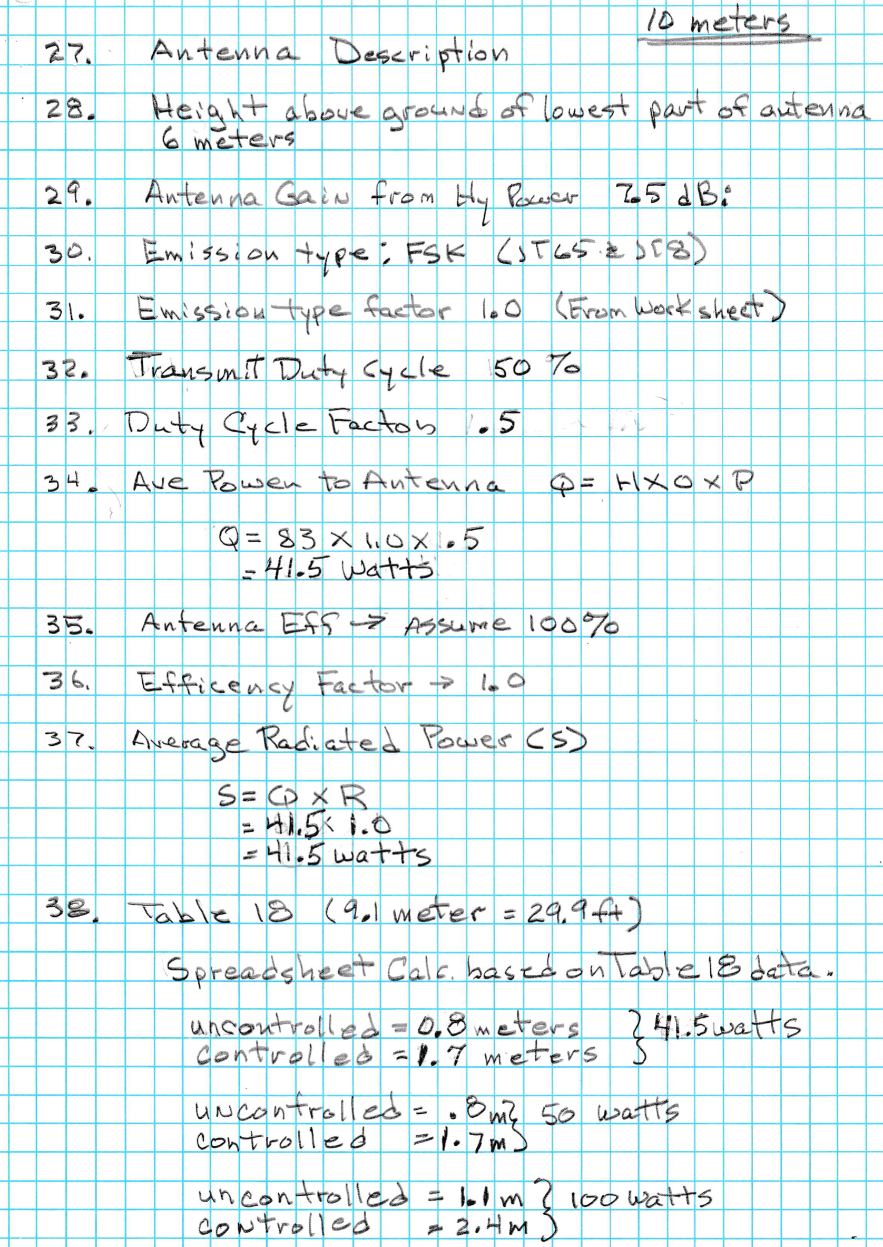

Slide 11
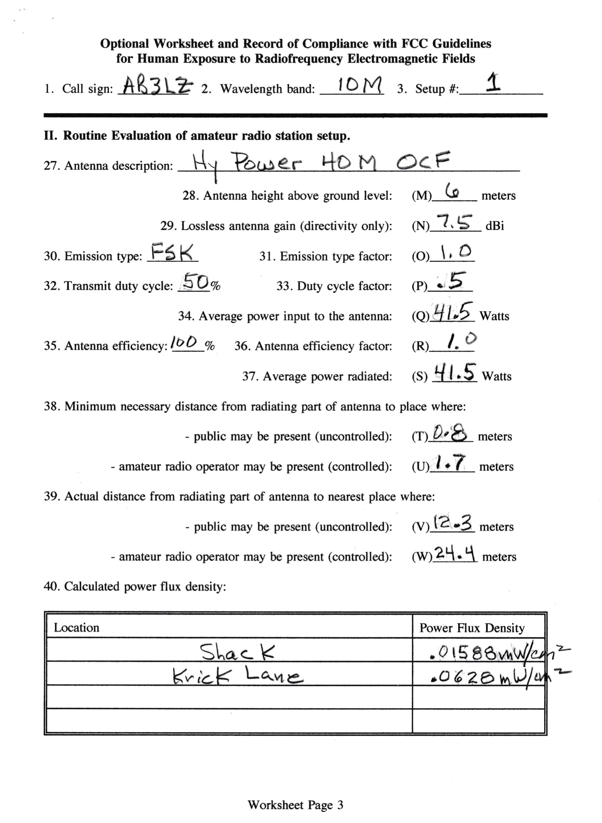
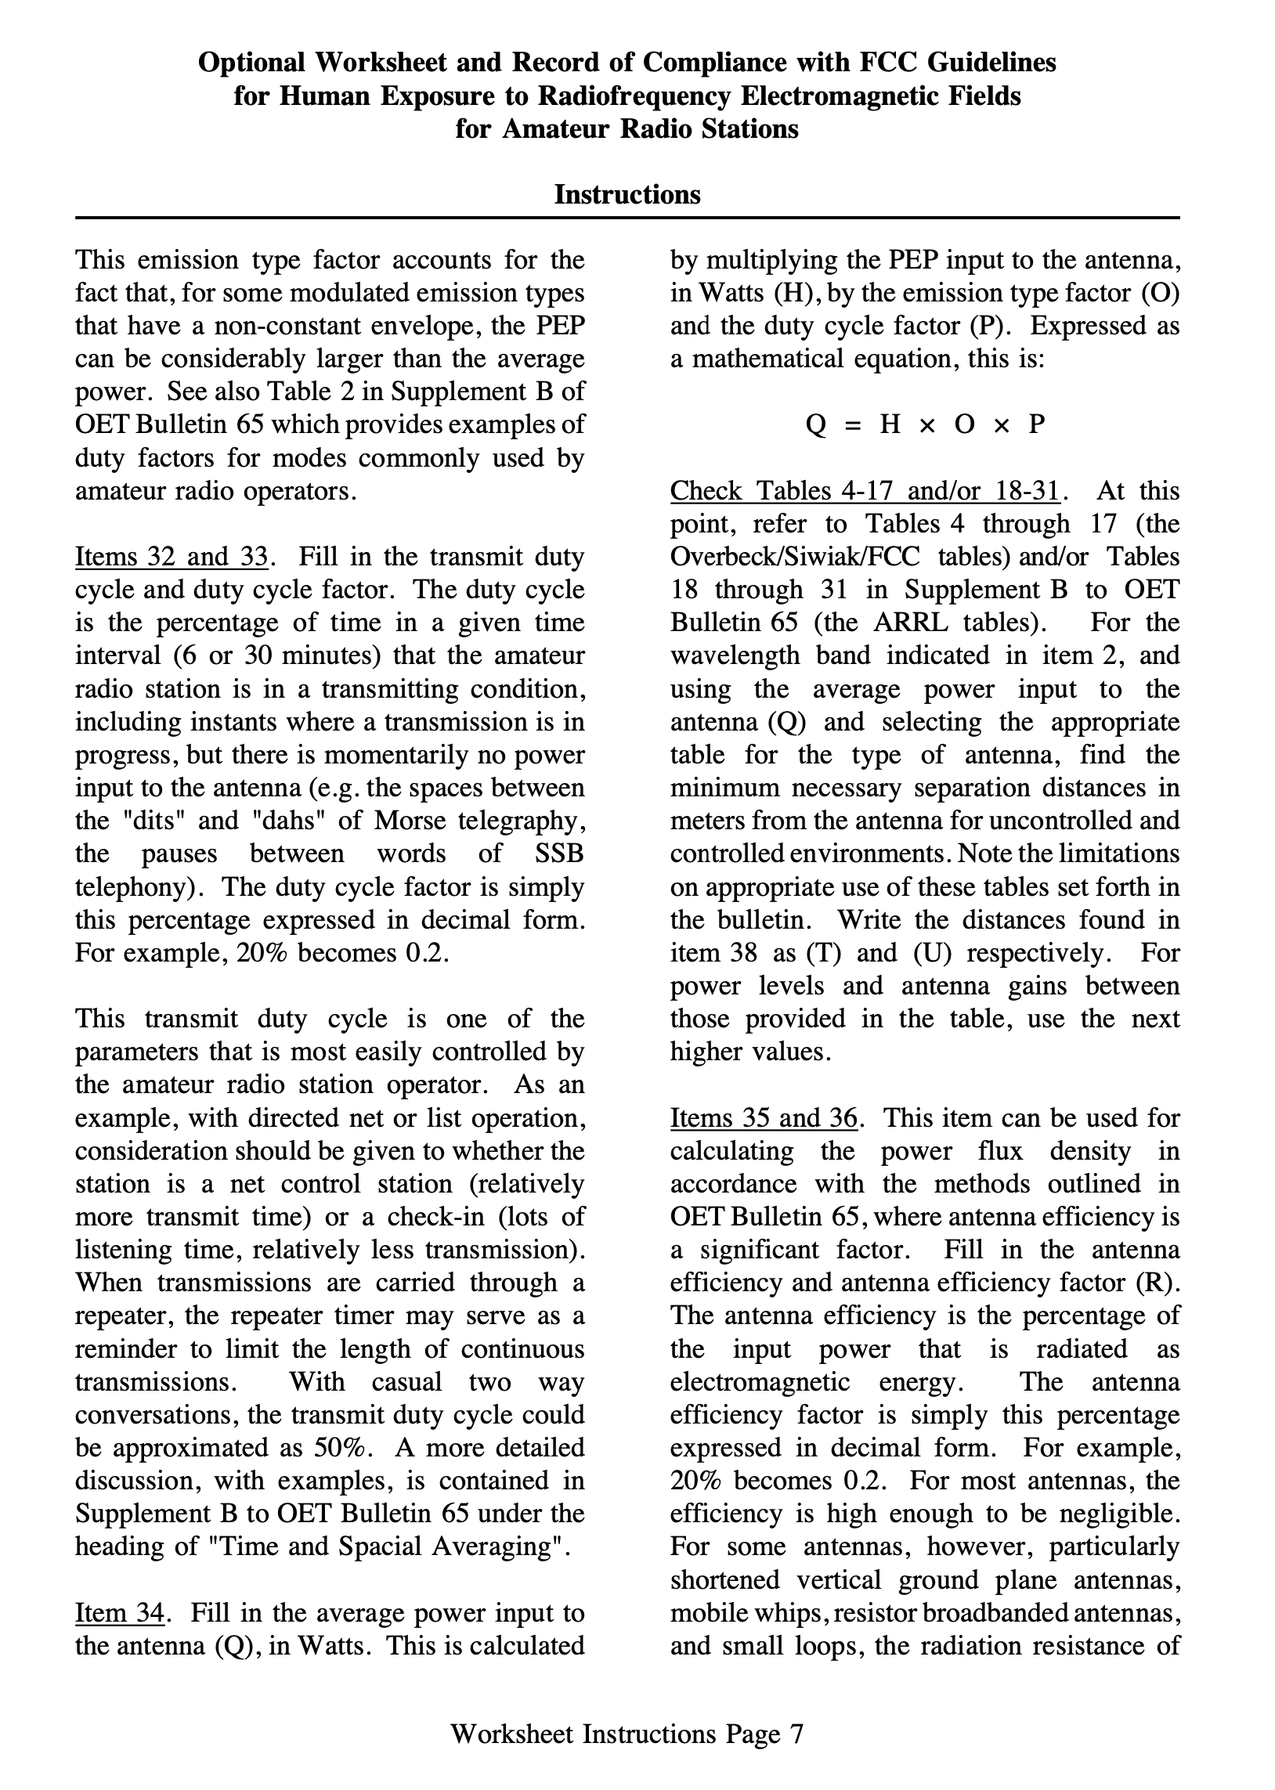

Slide 12
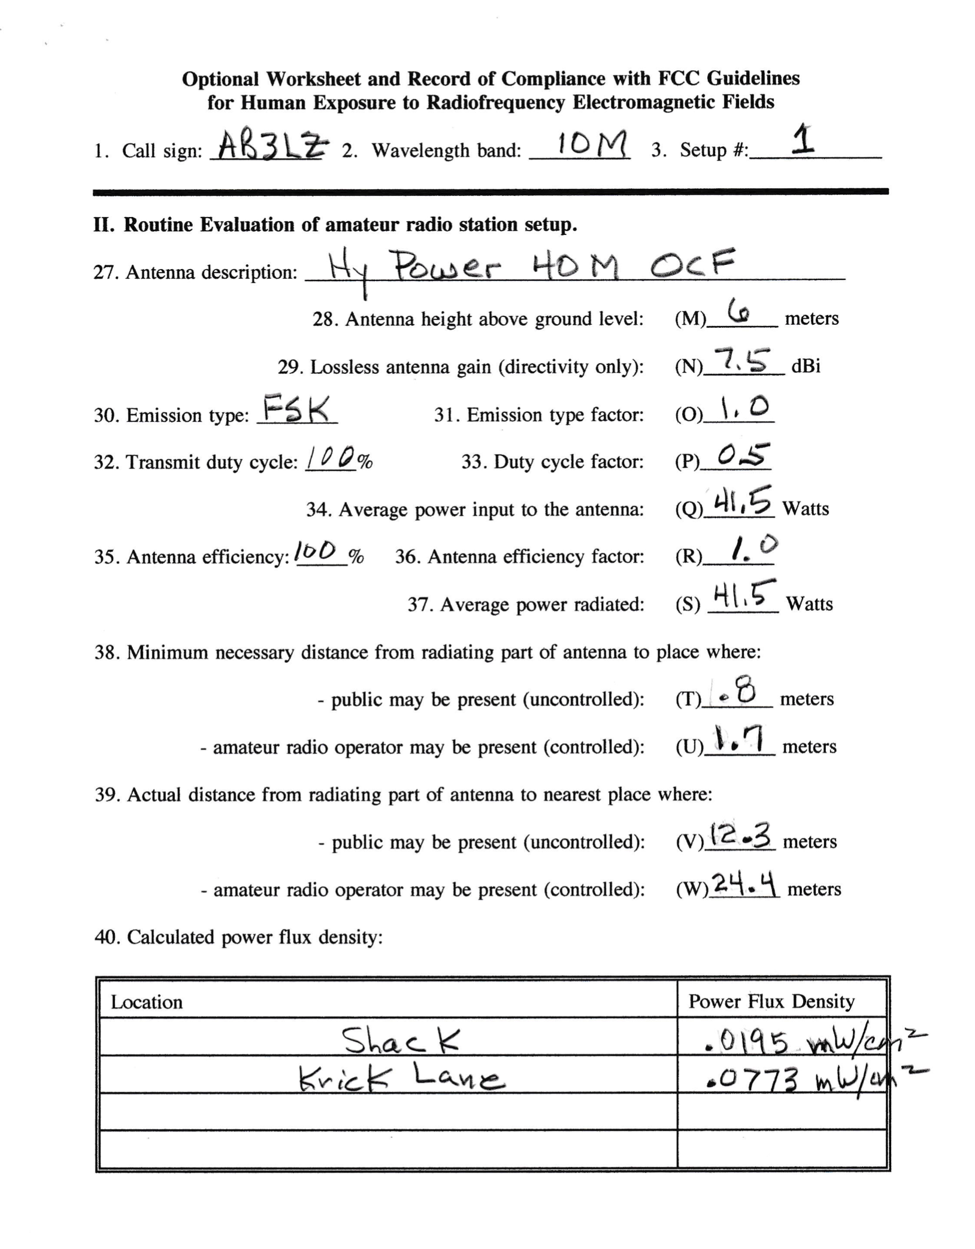
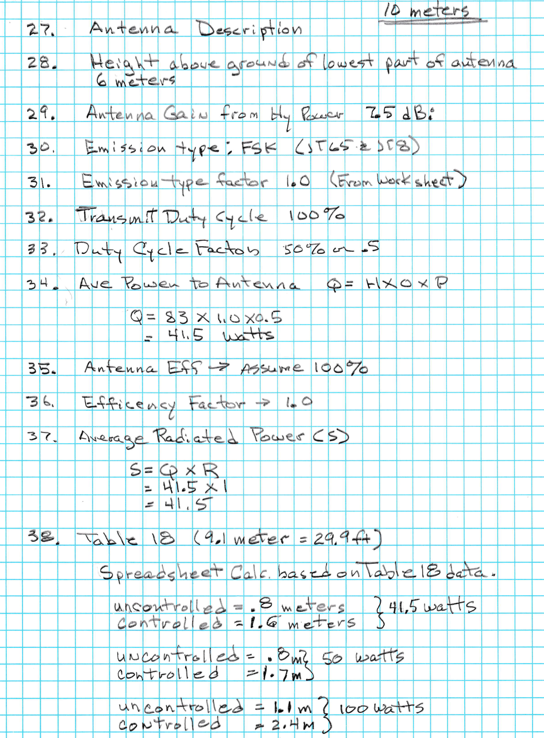

Slide 13
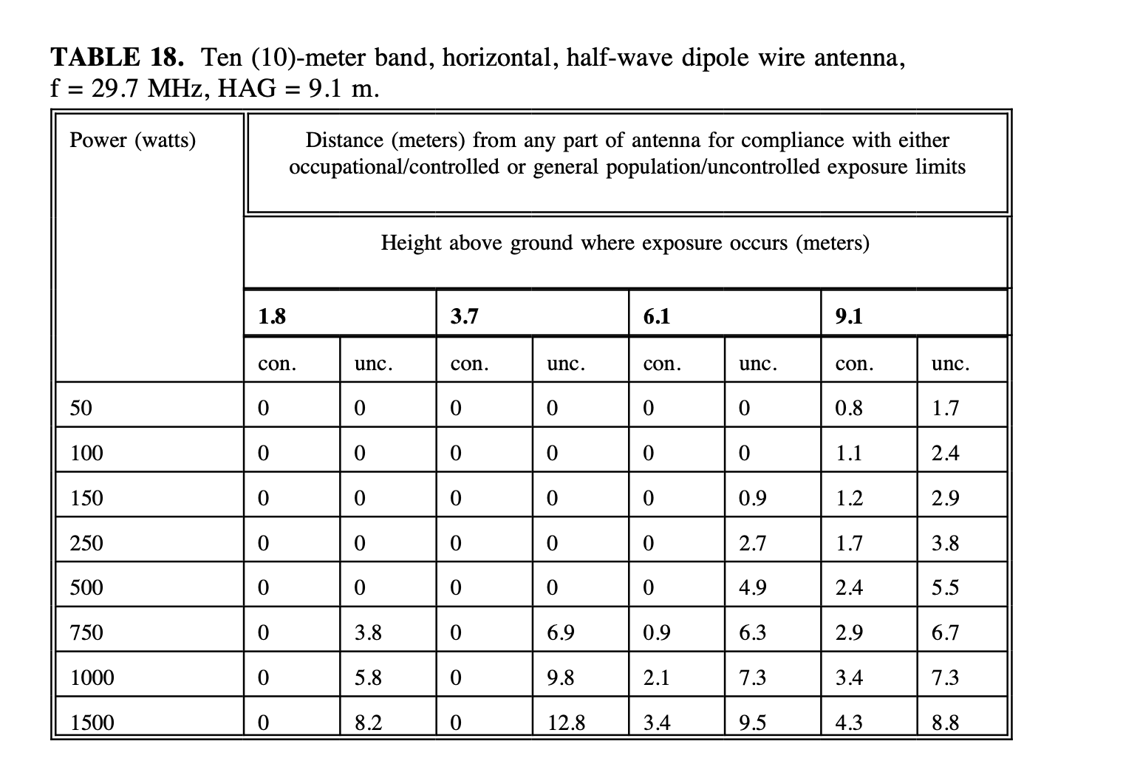

Slide 14
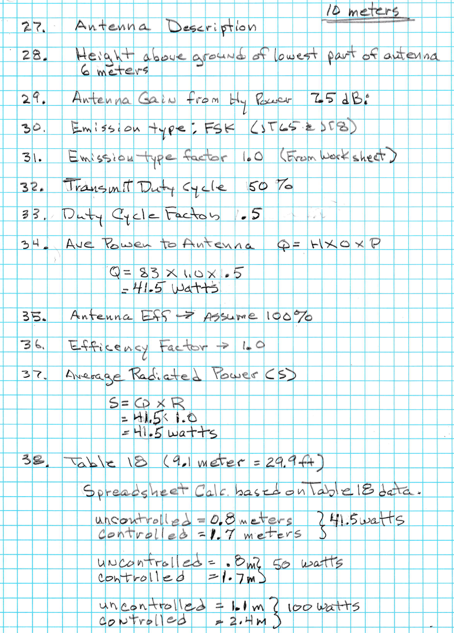

Slide 15
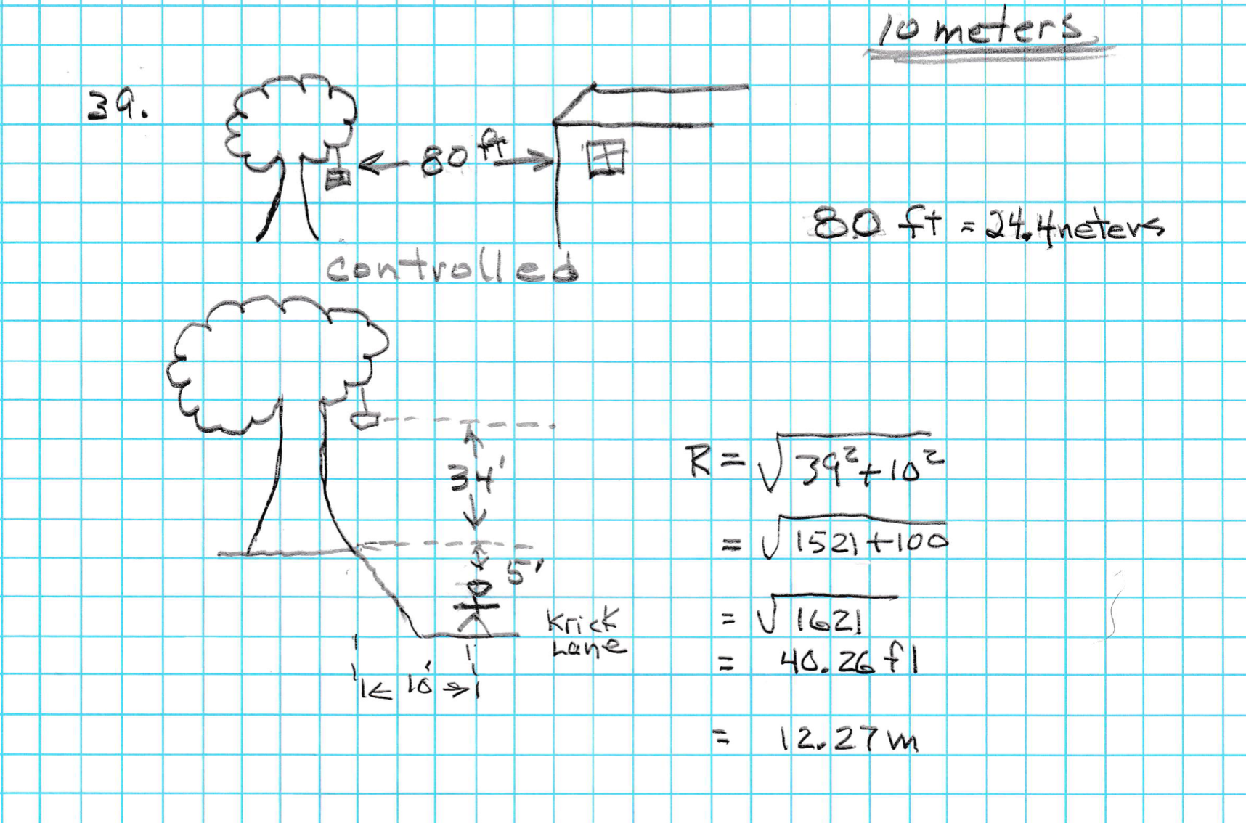

Slide 16
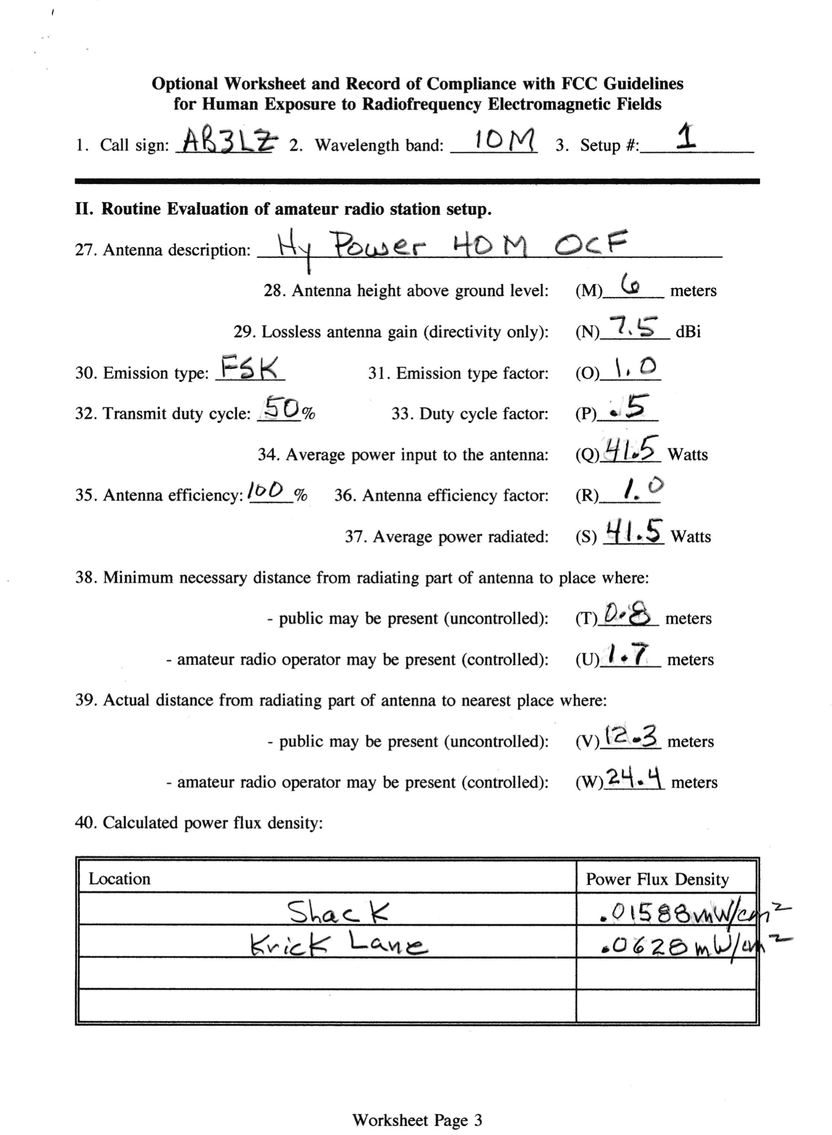

Slide 17
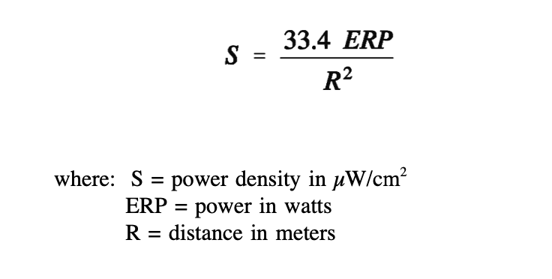
Power Density Calculation
ERP_{dBw}=PEP_{dBw} + Antenna Gain_{dBi} – 2.15

Slide 18
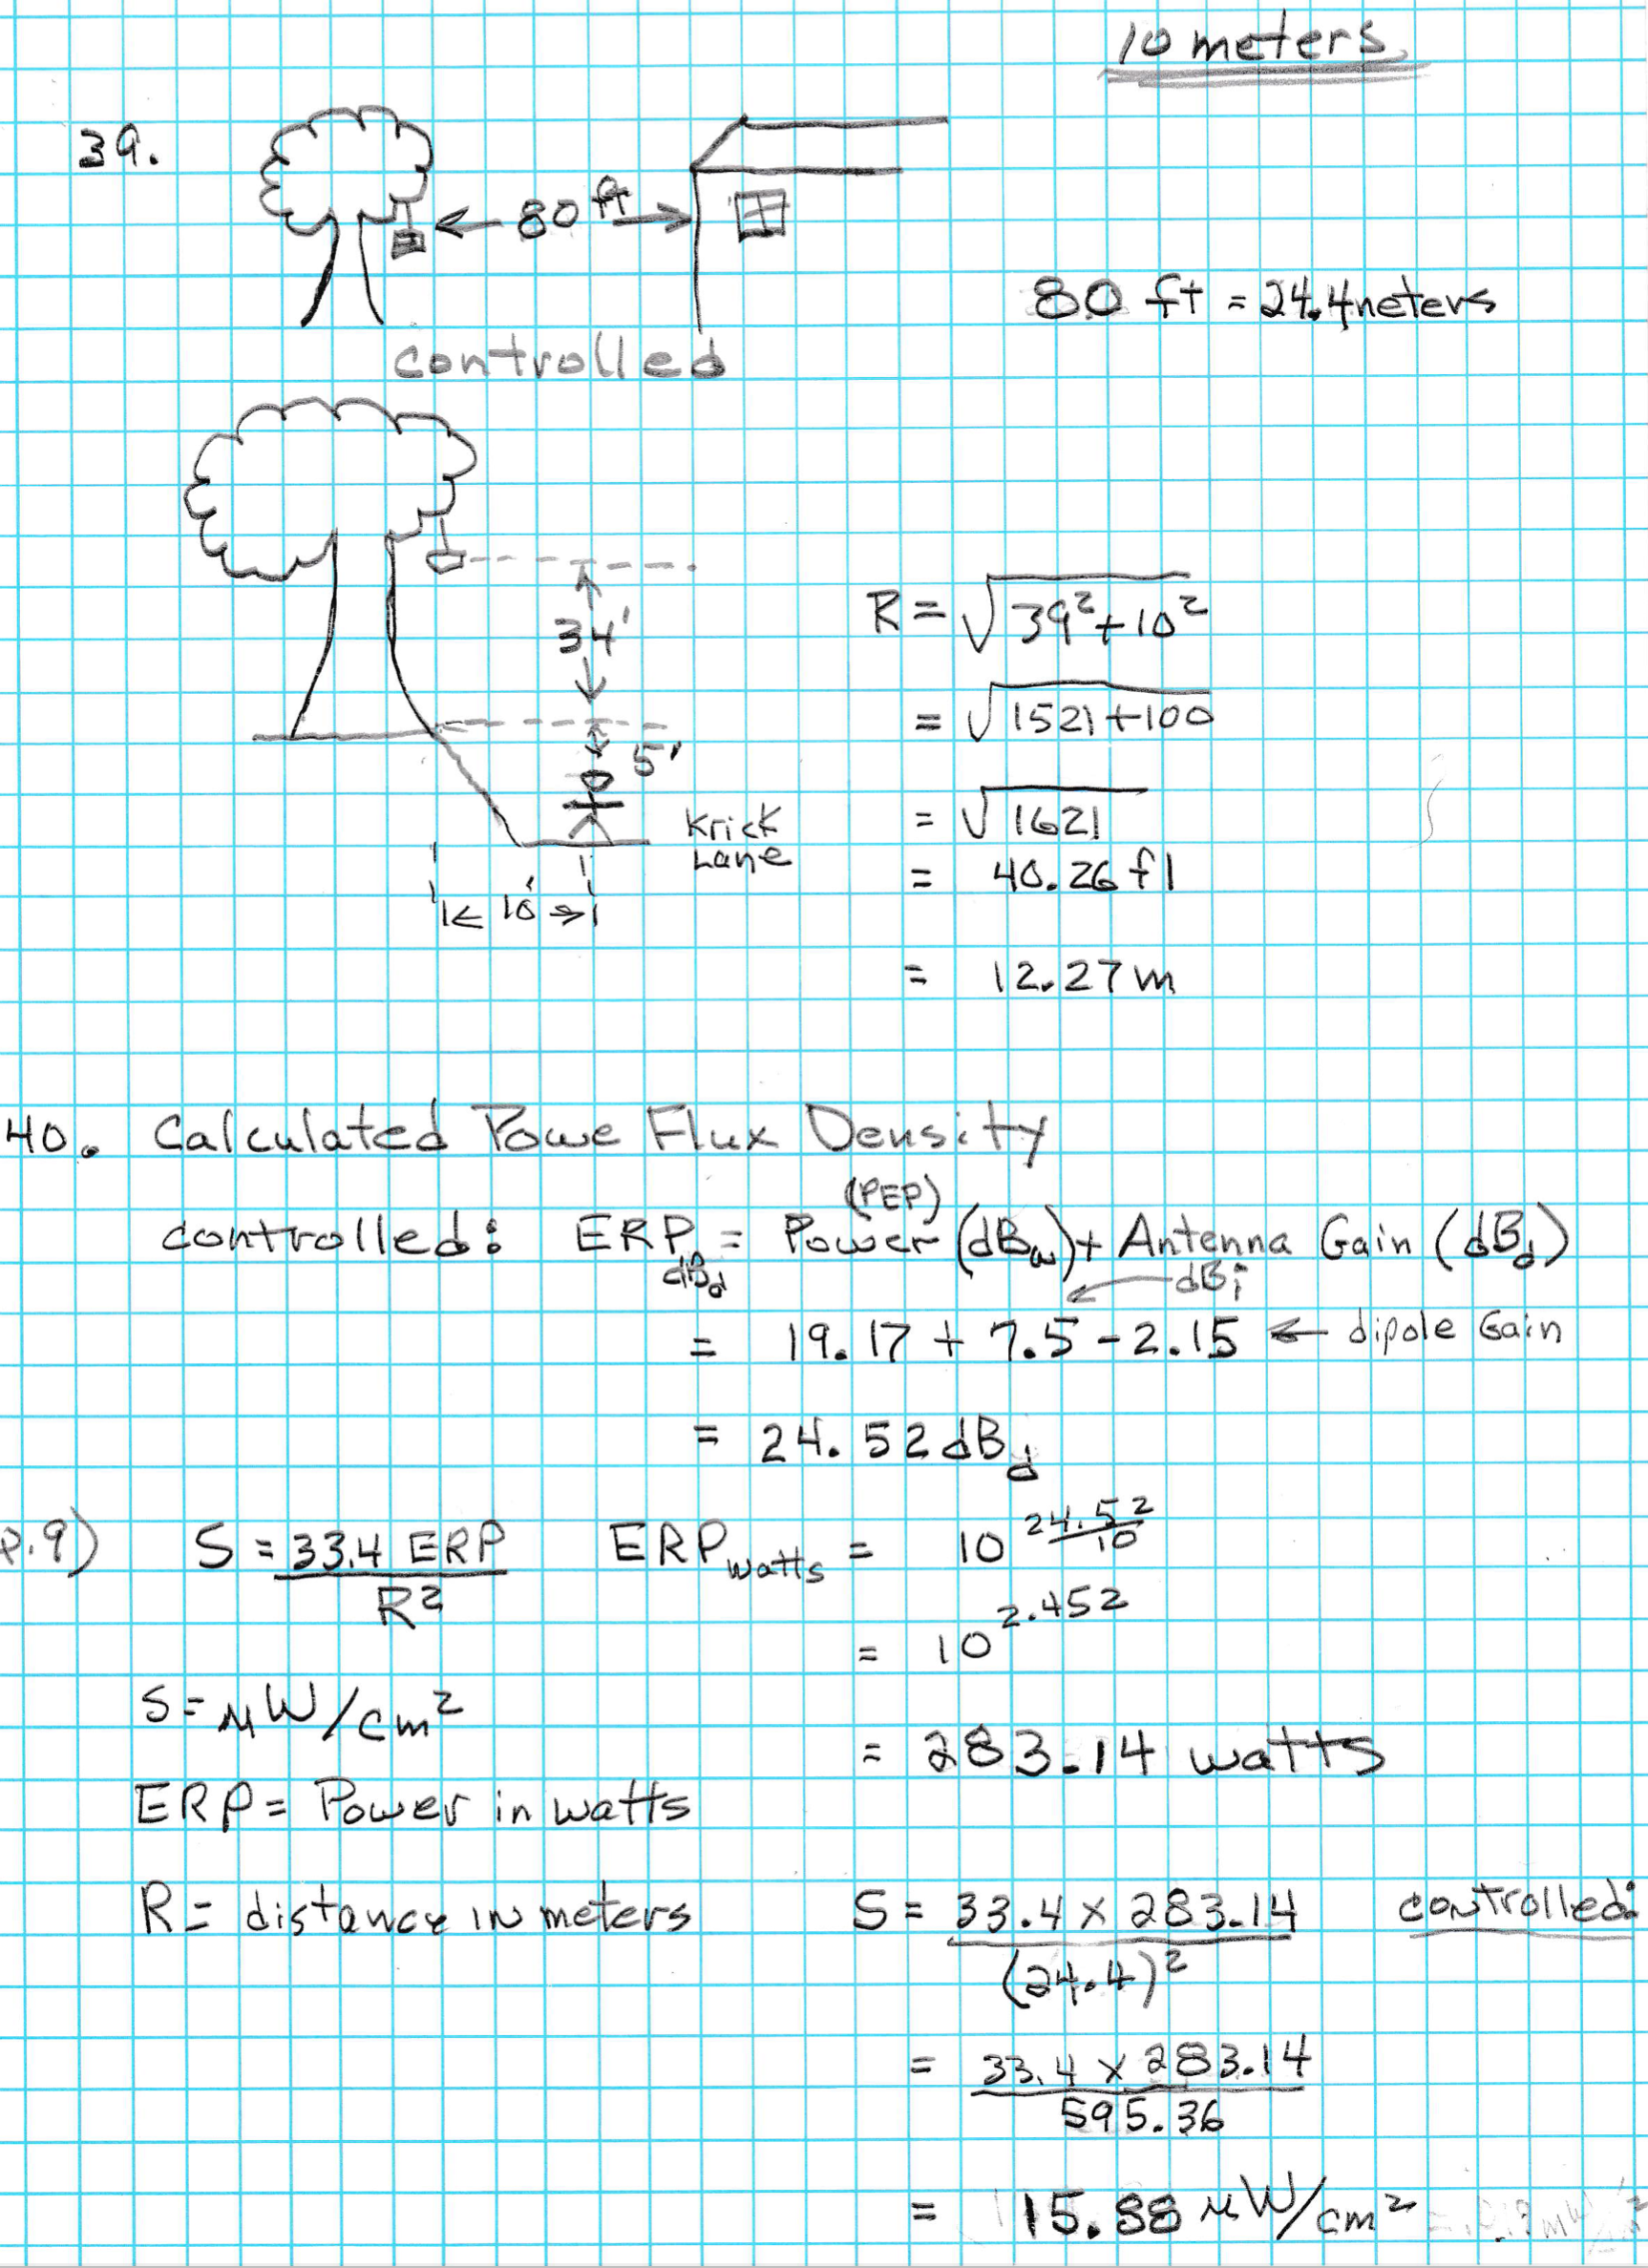
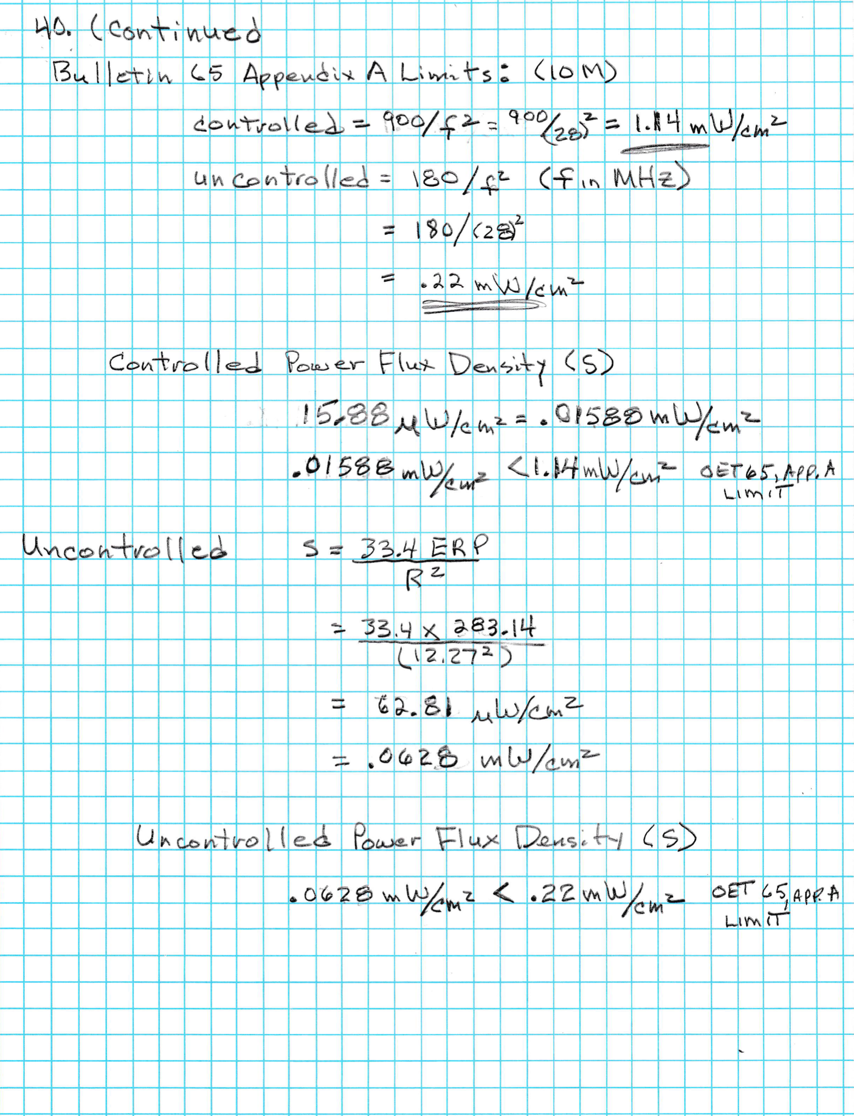

Slide 19
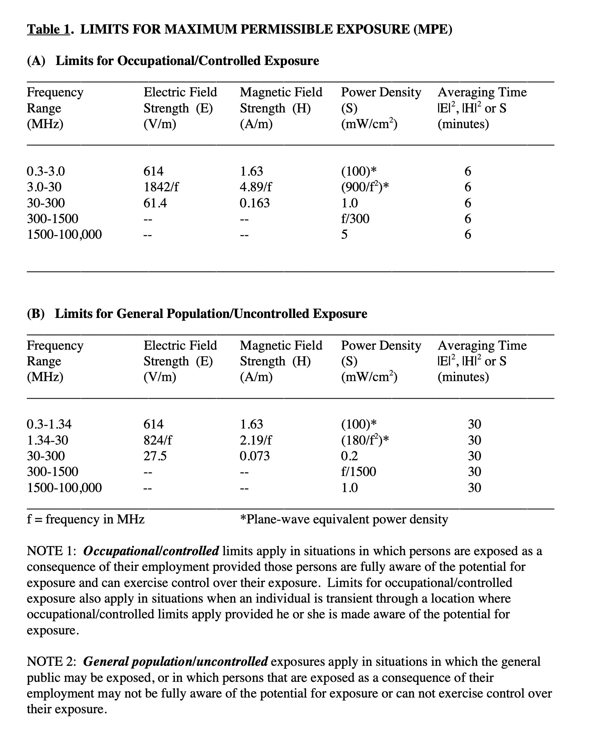
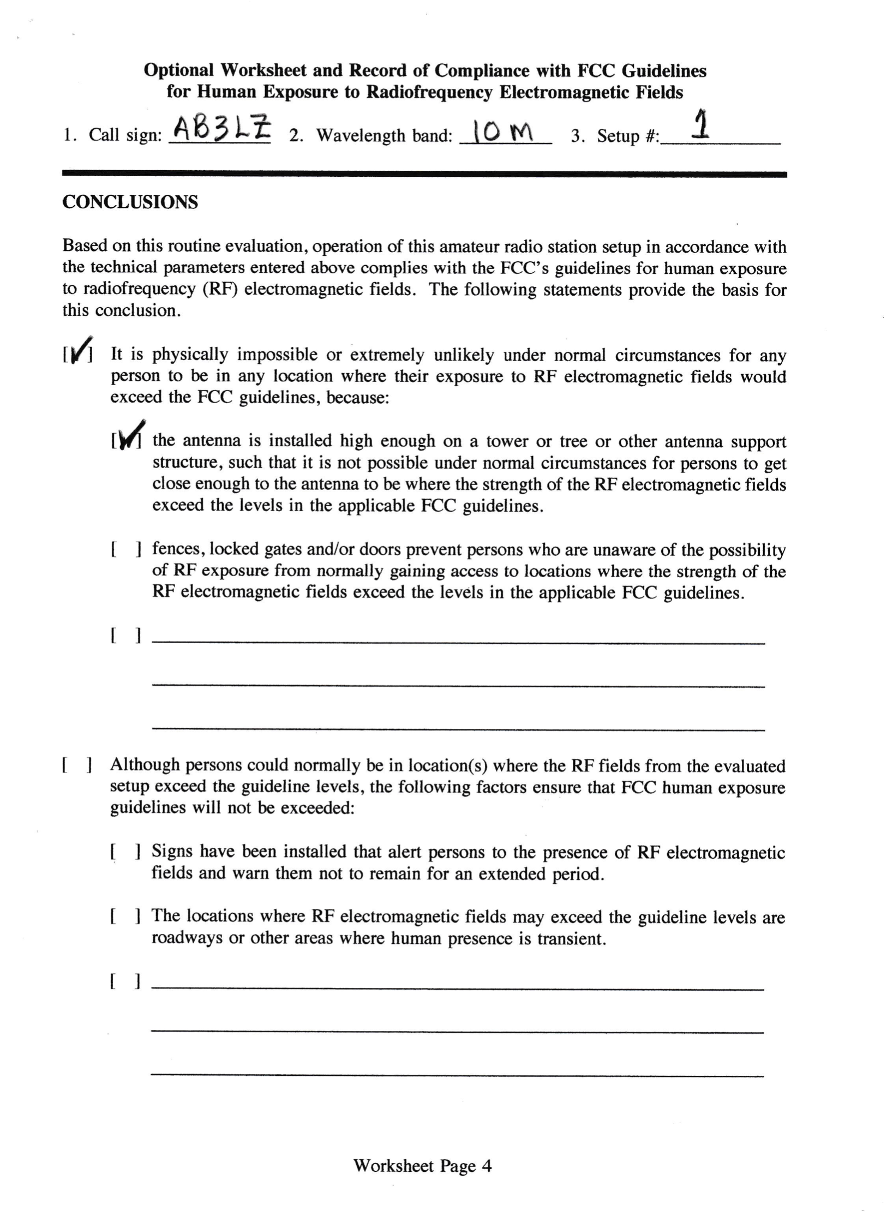

Slide 20
Questions?
Comments!

